Slide 1
Painting 1, Day 2
8.22.2019

Slide 2
Welcome Back to Painting 1
At the door you should’ve picked up:
12 pieces of 8x10 paper(normal size paper)
2 pieces of long paper
One piece of little long paper
Please be ready with all your papers for instructions when the bell rings
We are going to make…two sketchbooks!
Do you have your disclose signed? And/Or art fee paid with your receipt?

Slide 3
Ready
Looks like:
Eyes forward
Materials picked up and in front of you
Phone away(preferably in your bag so the vibration doesn’t distract you)
Sounds like:
Lecture environment to start so that we all can hear instructions
Questions, please ask, someone else probably has the same question as you

Slide 4
Agenda
Gather supplies at the door
Reminder of what being ready in class looks like and sounds like
Go over book binding.
Create two sketchbooks!
Exit Ticket
Questions about today?

Slide 5
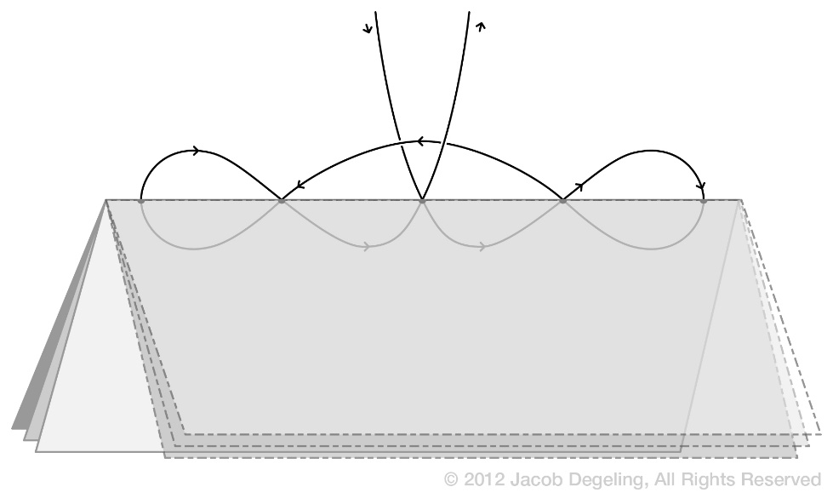
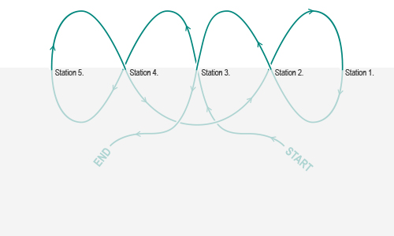
Studio Time 8.22.2019
Stitch your book and tie off.
Write your name on your book and class period

Slide 6
Extra Time, Done with both your books?
Decorate the outside of your book with colored pencils or you can paint with watercolor
Hint: the paper is drawing paper, so don’t use too much water when you paint your book

Slide 7
Next Class
Pick up paintings from last class
Add to sketchbook
Glue steps/instructions next to your painting techniques
Add 1st BL painting and 2nd BL painting along with reflection

Slide 8
Last few Minuets of Class 8.22.2018
Place your sketchbook in the hanging folder for your class periods
You have a hanging folder with your name on it
The folders are in alphabetical order by last name, please don’t move your folder – thank you!
Remember to take: Disclosure to Parents/Guardians to sign and bring back next class, also remember to pay your art fee at the bookstore, Mrs O’Grady will give you a receipt to turn into me, so I know you have paid – thank you!

