Slide 2
2.24.2020 Figure Drawing Unit
You will need:
A manikin – on the cart when you walk in
Your sketchbook - in your hanging file
10 pieces of newsprint paper
A shading pencil packet – on back counter
Eraser
Sharpener
Clipboard – in open cupboard
Thanks for being ready with those supplies

Slide 3
Agenda
Gather supplies
Learn the basics of figure drawing using a manikin
Address proportions and ratios of drawing the human figure
Practice
Next class more practice and notes
Be thinking about what type of pose you would want to do for your project

Slide 4
Be kind to the manikins

Slide 5
Poses
1)figuring is facing you
2)side view of the figure
3)figure is looking away from you
4) figure is walking or hooping
5) Figuring is creating a full body action

Slide 6
2.26.2020 Drawing 2: Day 2 Figure Drawing Unit
You will need
Your sketchbook
And one of each…
Pencil
Skewer
Manikin
Clipboard
About 3 pieces of nice drawing paper

Slide 7
Let’s Review Last Class

Slide 8
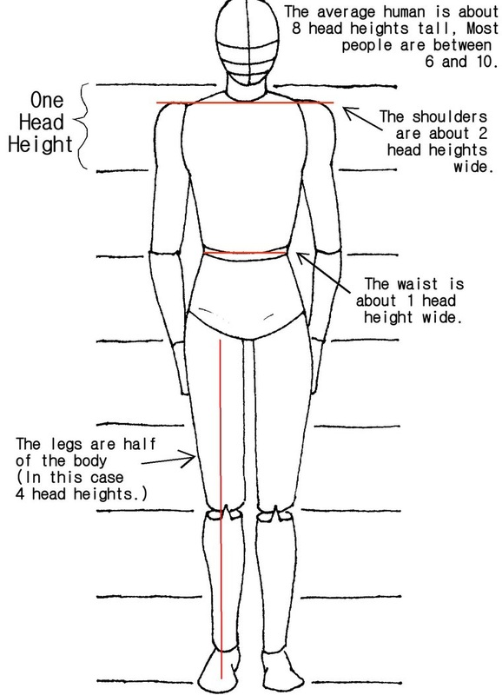
Figure Drawing Basics
Notes

Slide 9
More info just as an FYI

Slide 10
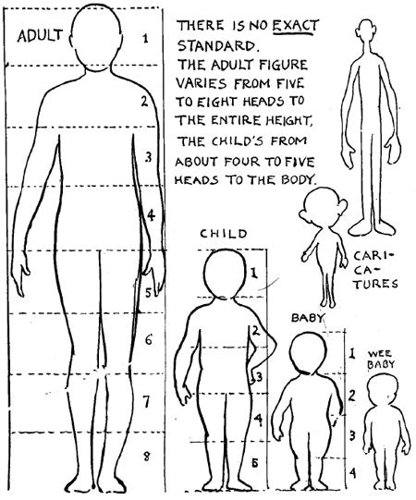

Slide 11
Set Up your space Pencil Eraser freedom to move sit up feet flat

Slide 12
Using a skewer to measure the distance of the height of the figure.

Slide 13
Using a skewer to measure the distance of the width of the figure.

Slide 14
Notice that using the end of the skewer for the top of the measurement and your thumb for the bottom of the measurement is a way of keep things consistent. Develop habits like this and they will become comfortable and reliable for better drawing practice.

Slide 15
Once you have your height and width measurements, then you can estimate the rectangle that the figure fits within on your drawing paper. This is a notional space.

Slide 16
After using the skewer to find the halfway point between the top and bottom of the figure, you can estimate where the center point is in your notional space and mark it lightly in pencil.

Slide 17
FINDING TILTS ENVELOPE ANGLES

Slide 18
Tilts and distances
We will apply this concept as we draw
Using the skewer to find the tilts(follow through lines) and the distance between objects to line them up

Slide 19
Exit Pass 2.26.2020
Please be honest with yourself to make the reflection valuable
1) What technique helped you the most today and why?
2) What technique did you struggle with or find confusing and why?
3) When we start the figure drawing assignment next week, what is your greatest concern thus far?
Thanks for challenging yourself to try some new techniques and struggle to make it an autopilot response for you! It’s not easy to train your brain, but once you do, that is a gift you’ve given yourself that no one can take away.

Slide 20
Next Class
Drawing Horses and Poses

Slide 21
Everyone will pose at least once
We will practice each step
The goal is to make this type of drawing something that will be an autopilot for you
The more you practice it, you won’t even think about it
Your drawings will be in better proportion, accurately lined up, and over time you will naturally see how to draw people quickly and effortlessly

