Slide 1
2.8.2019

Slide 2
In your hanging file find:
The small monochromatic painting we did last class and your watercolor sketchbook
Glue it and the description for monochromatic in your watercolor sketchbook
When you are done, return your sketchbook to your hanging file and
Pick up an Ogden Trails Project Proposal Form
Using your phone check out the following website: http://trails.ogdencity.com/

Slide 3
The Site is Interactive so you can check out the trails and see some pictures of them

Slide 4
Agenda 2.7.2019
Sketch out ideas for Ogden Trails Stewardship Through Art Contest
Find an image that you want to paint – apply what you learned about atmospheric perspective with the monochromatic painting last class
You will have 3 class periods to work on this painting
DUE 20th of February

Slide 5
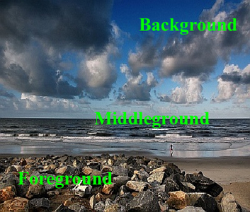
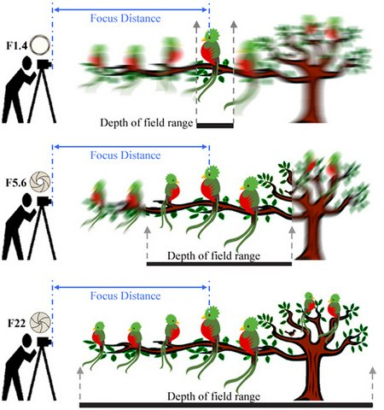
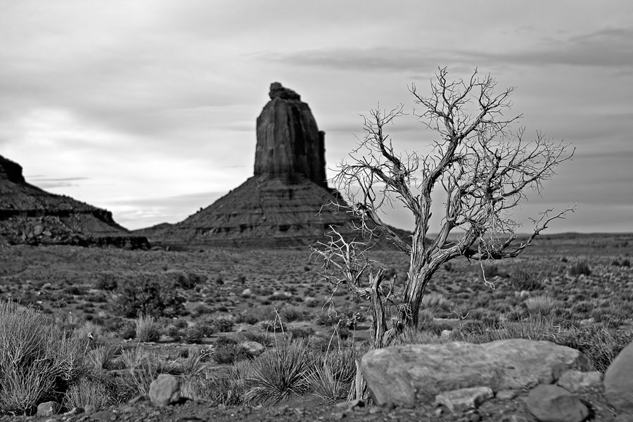
What do you think a landscape needs to have to give it depth?
Depth of field
The distance between the nearest and the furthest objects that give an image judged to be in focus in a camera.
In photography this is used as a focal distance

Slide 6
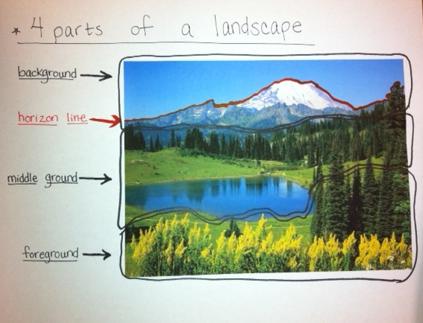
Dividing a landscape
There are at least 3 sections in a landscape.
The background
The middle ground
The foreground
Draw on your photograph now the horizon background line, horizon line, middle ground line and foreground line.

Slide 7
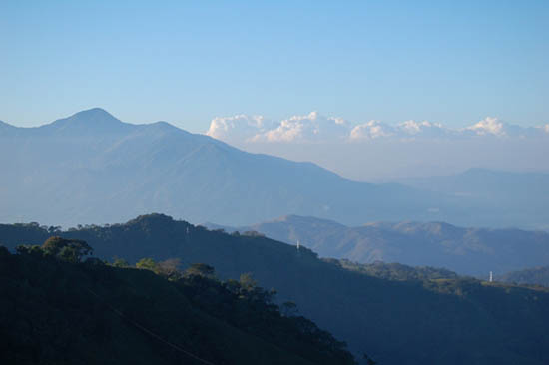
How to show atmospheric perspective

Slide 8
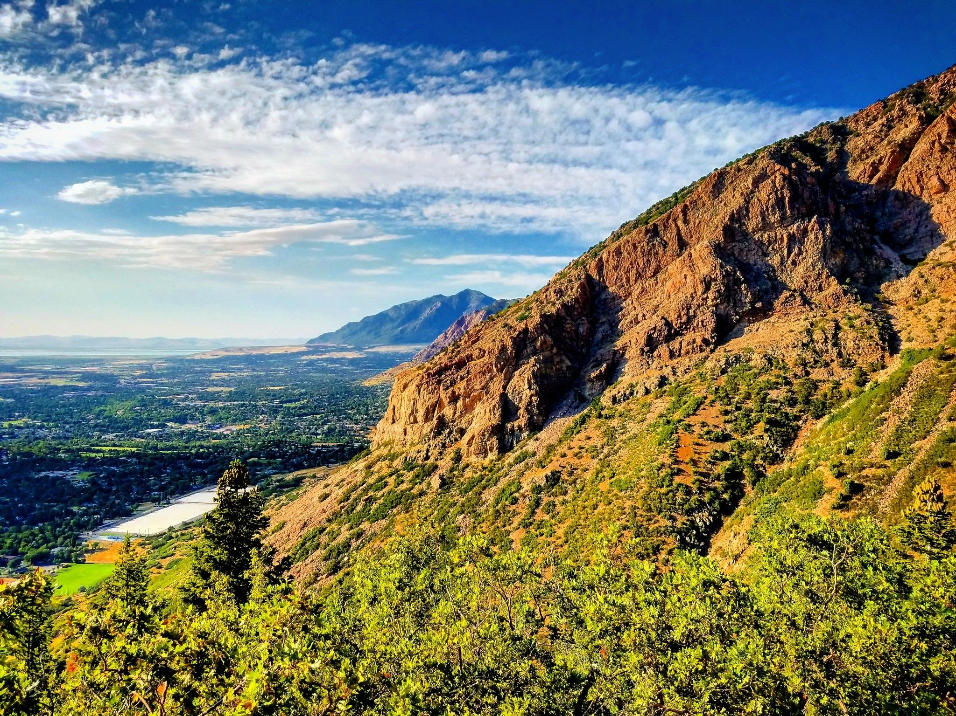
Project Expectations
Include a - Foreground, middle ground and background
Foreground – detail and brighter – usually paint last
Middle ground – a little less detail and duller – paint second
Background – dullest(atmospheric perspective) and the least amount of detail -paint first
Everyone that enters the contest – get’s a free t-shirt
Top prizes, $100-!

Slide 13
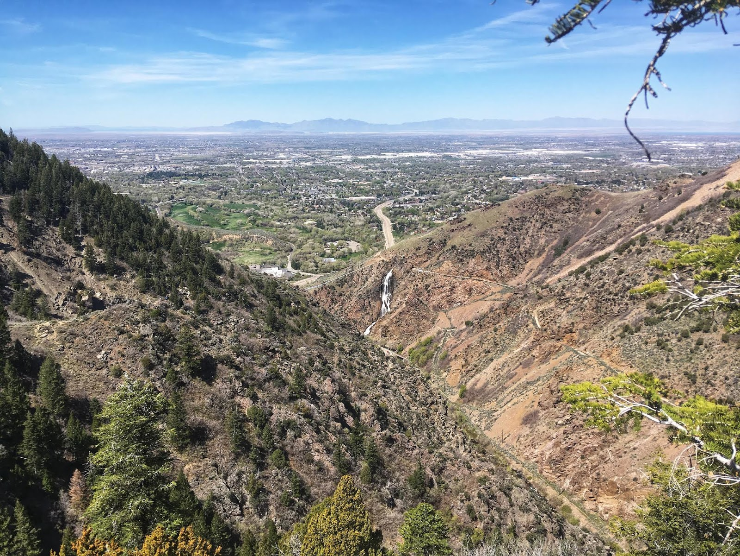

Slide 14
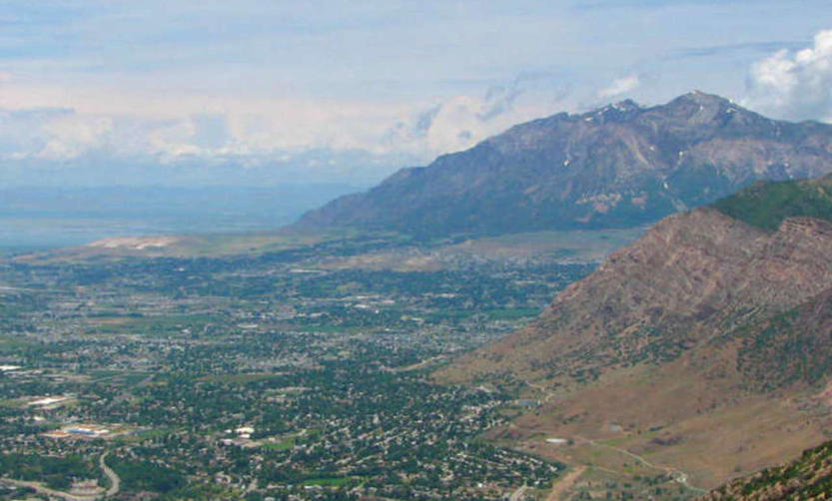
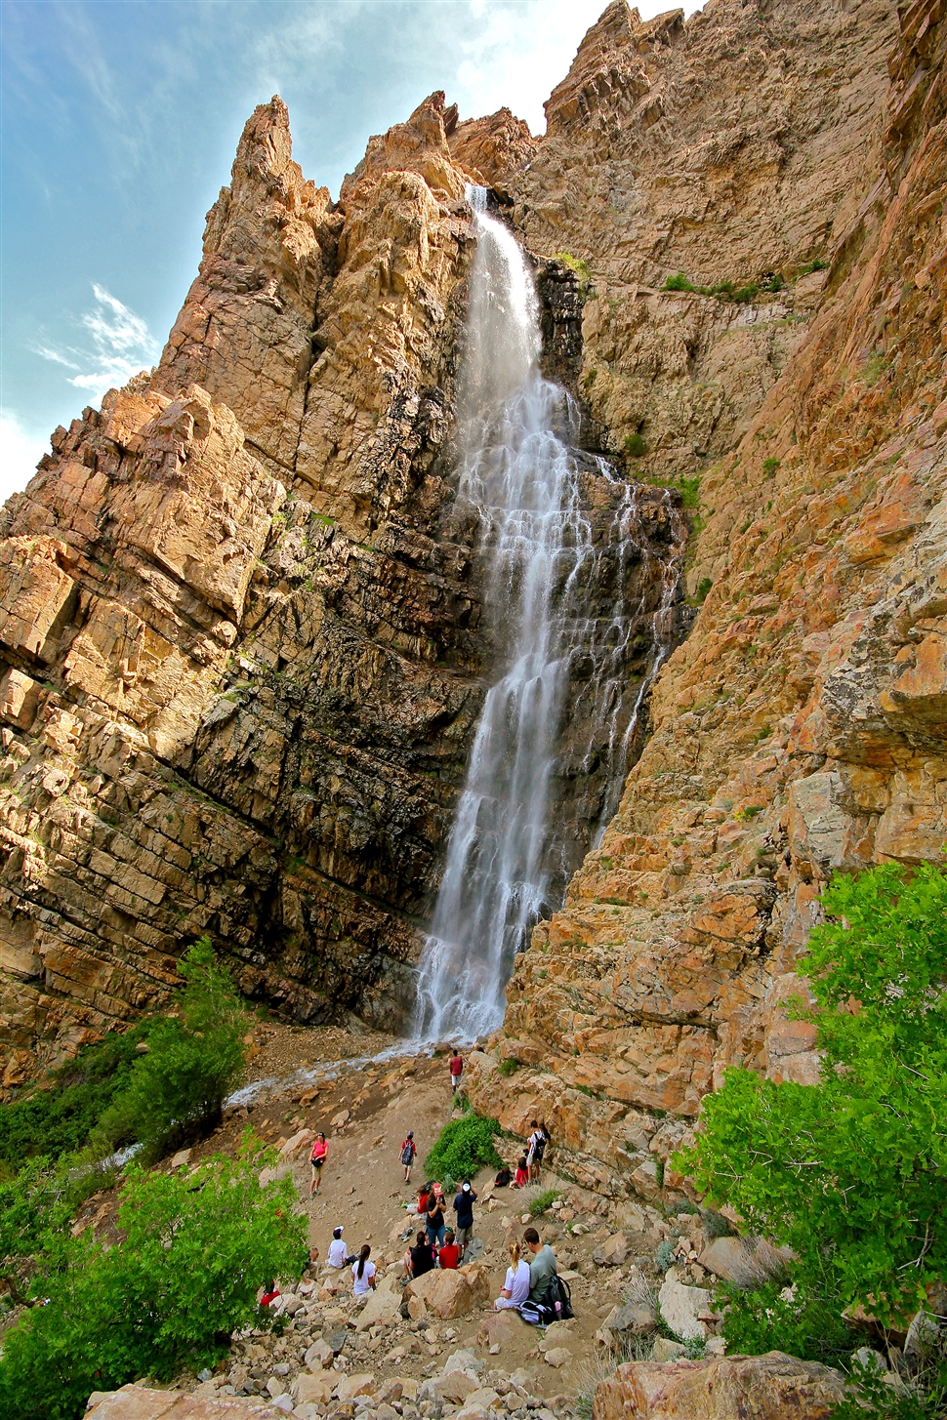
Ogden Trails Landscape
Project Proposal Form
DUE on Feb. 20th
Ogden Trails – trails on this side of the mountain - http://trails.ogdencity.com/

