Slide 1
First Day Drawing/Painting 3
8.19.2019

Slide 2
Welcome Back to Drawing/Painting 3 8.19.2019
At the door you will need to pick up:
Class survey
A disclosure
Please start on survey for Drawing/Painting 3
Thank you!

Slide 3
Supplies you will need
Scissors
Glue stick
Paper – pick out different papers that you like
Cardboard
Take your supplies back to your seat
Please be ready with all your supplies and wait for instructions once everyone has found their way back to their seat

Slide 4
Ready
Looks like:
Eyes forward
Materials picked up and in front of you
Phone away(preferably in your bag so the vibration doesn’t distract you)
Sounds like:
Lecture environment to start so that we all can hear instructions
Questions, please ask, someone else probably has the same question as you

Slide 5
Agenda
Survey – bell work
Gather supplies
Reminder of what being ready in class looks like and sounds like
Who’s Mrs. Lyon and Who are all of YOU!
Quick FYIs about the class
Disclosure – we did last class
Class Routine
Start first project - HIVE
Dem & visual notes
Exit Ticket
Questions about today?

Slide 6
Who is Mrs. Lyon?

Slide 7
Professional Artist

Slide 8
www.ericalyonart.com
Art Shows
in Ogden
The Front – climbing gym(Dec. 2017)
Café Mercantile – 26th St.
Second Track Sports – 12th and Harrison
Blooming Lotus Café – 25th Street
Gear30 – on Wall Street
Wasatch Roasting Co.(Nov. 2017)
Eccles Community Art Center State Show – 2 pieces 27th and Jefferson
Eccles Community Art Center will be celebrating their 125 anniversary on Saturday!

Slide 9
Lived in Ghana, West Africa for 2 years teaching art to Deaf students

Slide 10
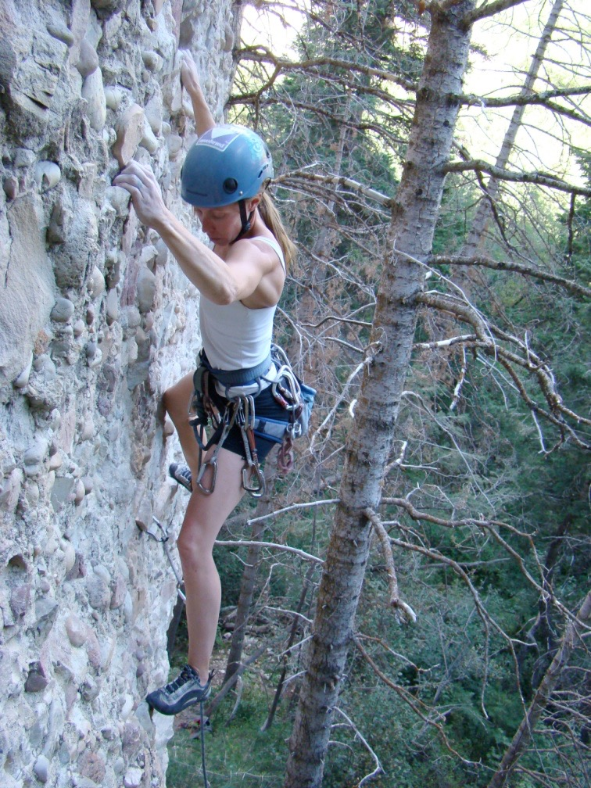
Climbing!

Slide 11
Backcountry Skiing

Slide 12
3 Ironman's completed!
2.4 mile swim, 112 mile bike, and 26.2 mile run

Slide 13
Love of my life!

Slide 14
Mrs. Lyon’s Teaching Thoughts about Art Class
Everyone and thing has value, treat it as such
Learning needs to be fun, challenging, and applied
Self-awareness is crucial in art, being able to take risks, and challenge yourself is key

Slide 15
Lyon’s faults
It’s challenging for me to spell
It take me a few months to memorize names

Slide 16
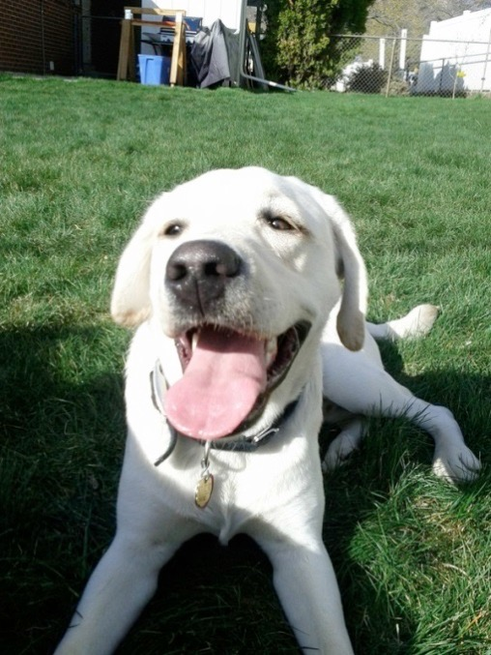
Griffin
Therapy dog ☺
No food or candy
Let him chill on his matt in the back
During studio time he will be walking around
Greeting people at the door daily
No whistling or calling his name - thanks

Slide 17
Quick FYIs
Disclosures - get signed and bring back = extra credit
Recycling, sink, trash, paper towels, band aids
All art supplies you need for class will either be at your table, at the door to pick up or on the back counter
Everyone will have a file folder for all their papers
Tables and chairs - we move, they move
Art work will stay in your class folder
Daily SCOTS Points – based on class expectations SCOTS
Hall Pass – you will get three, they will be printed on a paper that can fit in your binder
Not during lecture, critique, or demo time, only studio time
Not during the 1st 10 min. or last 10 min. of class
Only 3 per term, must sign back of planner
Website! – www.classwithlyon.com
Questions?

Slide 18
Art Shows
Art Competitions 2018-19
Face Painting Fundraiser – help AP pay for their exam and work at the football games painting faces for donations
First Friday Art Stroll – The Local Artisan Collective October and December 2018 6-8pm
Winter Art Show & Music Concert in the Commons at BLHS December 18th
Scholastic Art Competition due Dec. 4th, 2018 for more information go to: https://www.artandwriting.org/what-we-do/the-awards/categories/
Eccles Petite Impressions (under 8x8”) at Eccles Art Center in Dec. For more info visit: http://www.ogden4arts.org/competitions/
Utah State Senate Art Contest TBA
Utah State Art Show mid-Jan. 2019
Ogden Trails Network 3rd Annual Art Competition February 2019
Weber County Health Department Art Competition February/March of 2019
HOPE Art Competition around February or March of 2019
Art Gala in the commons at BL
Festival of Arts Beginning of April 2019 at Eccles Art Center
Recycled Art Competition Beginning of May 2019 at Eccles Art Center
Painting Competition at Eccles Art Center for more information: http://www.ogden4arts.org/competitions/

Slide 19
Disclosure
Review Disclosure together – did last class
Turn in

Slide 20
Class Routine Each Day
Bell Work - BW
Agenda, reminders, review last class
Lesson – demos, mini lectures, etc.
Studio Time! - Creating your art!
Review – what’s going to happen next class
Exit Pass

Slide 21
Goal for Today’s Class
Complete a drawing
More info about it in a second
Learn about an artist who wrapped objects and tied with string

Slide 22
Explore an Artist Christo and Jeanne-Claude

Slide 23
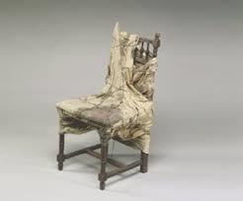

Slide 28
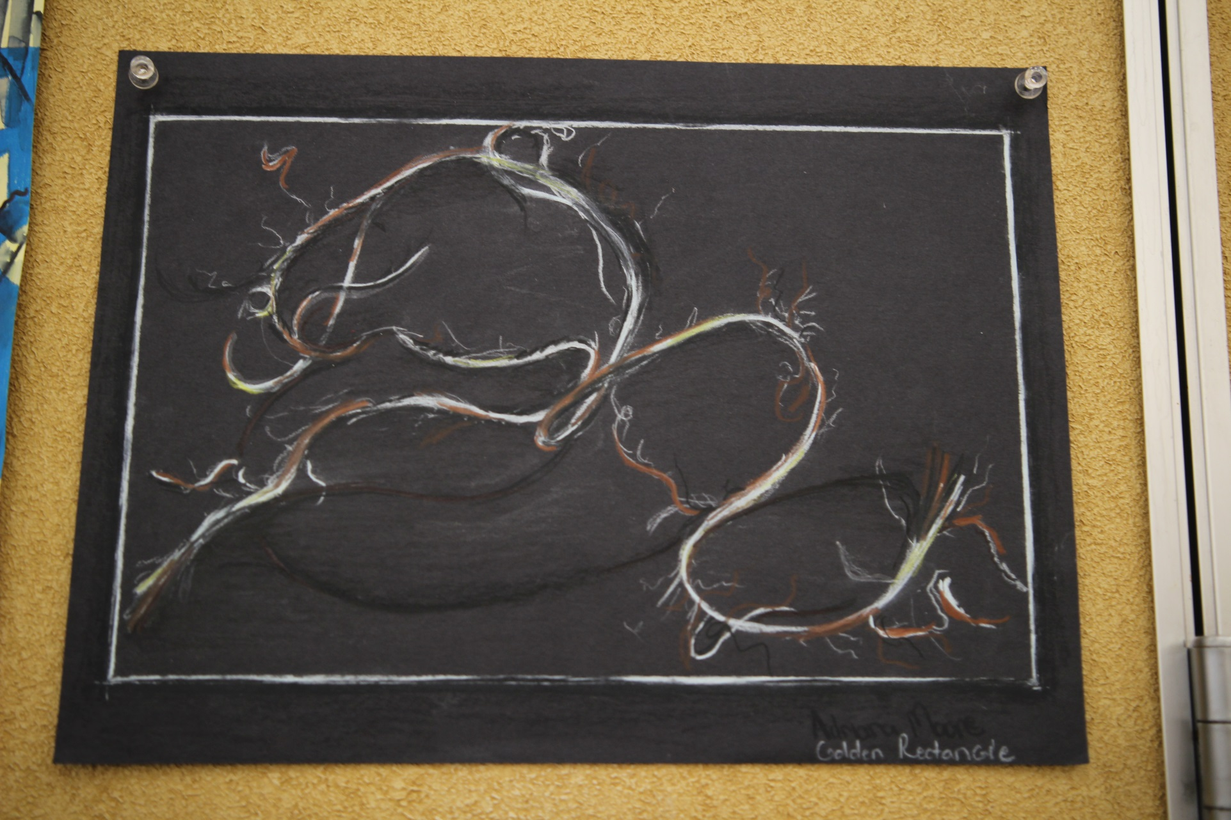

Slide 39
Studio Time
Draw an object that is being strangled, tangled or tied in string
This could be an object you have or one you find in the room
I’d take a picture of the object and change the image to B&W to get better contrast
If it’s easier for you to just draw the string, then do that instead of adding another object to it.
This is due by the end of class

Slide 40
Next Class 8.28.2019
Hand Drawings
Don’t worry we will learn some ways to ‘cheat’ to make it easier to draw hands

