Slide 2
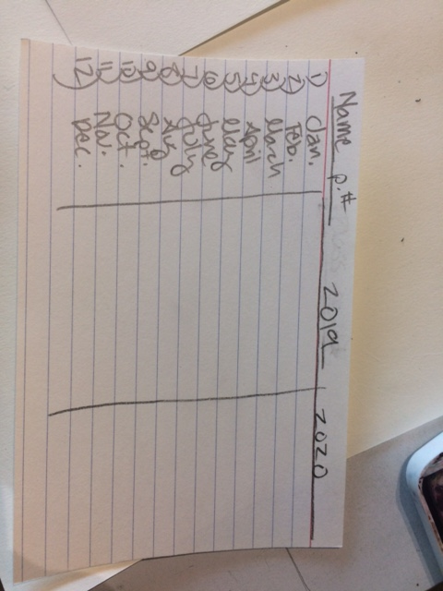
1.7.2020 Day 1 Mandalas
Set up your index card like this one -----------→
Write down something you remember from each month that happened last year
Do the same thing for 2020, but write down something you want to happen or things that you know will be going on that month
We are going to make a mandala for the last year and year coming up
This will just be a two day project(Thursday’s classes will only be 50 minutes so try to get most of the project done today and finish it up Thursday)

Slide 3
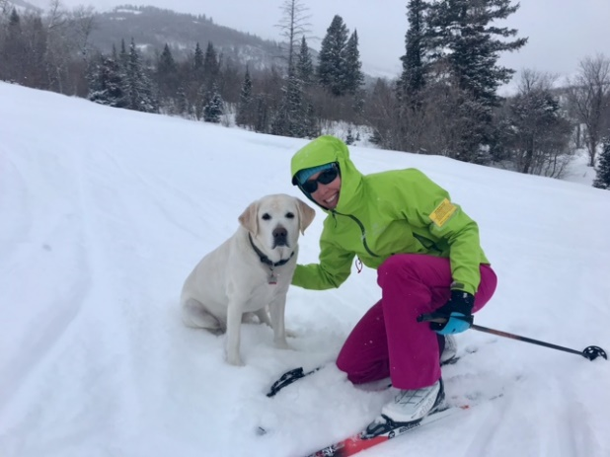
Reminders
Please bring back any checked out supplies
Pay your fee so you can take your art supplies home
Double check your schedule
If you need to make any changes do it this week, so you don’t get charged $
Thursday is a mini day

Slide 4
Thursday Jan 9th
Minimum Day
1st period | 7:45 | - | 8:35 | (50 minutes)
2nd period | 8:40 | - | 9:30 | (50 minutes)
3rd period | 9:35 | - | 10:25 | (50 minutes)
4th period | 10:30 | - | 11:20 | (50 minutes)
5th period | 11:25 | - | 12:15 | (50 minutes)
Lunch | 12:15 | - | 12:55 PM | (40 minutes)

Slide 5
AP on piece 8 of 15
Have you signed into my AP recently? – make sure you are taking pictures of your work and start uploading them to myAP
Senior Art Show ECAC
Opening reception this Friday! Awards will be posted that night!
State Art Show is coming up we can send in 13 pieces from BL, juniors and seniors can enter
April – Festival of Arts – our district art show

Slide 6
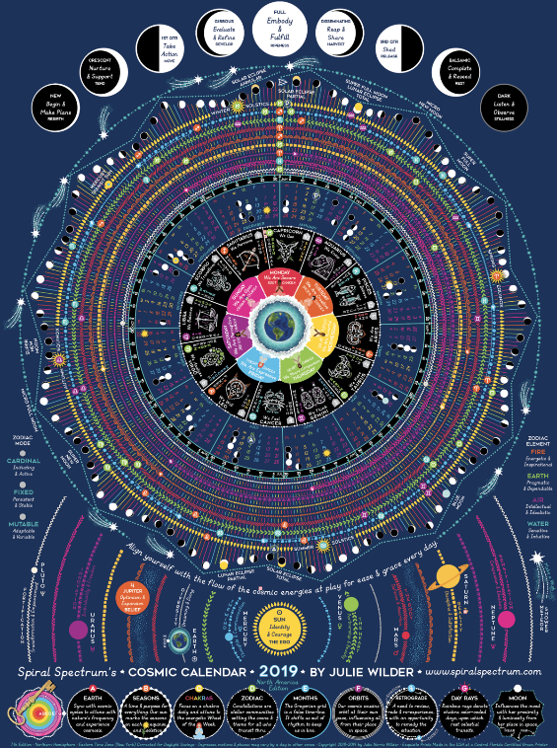
1.8.2020 Day 2 2019 & 2020 Mandalas Due @ the end of class
You will be turning in your index card with your mandala
You can use:
Symbols
Colors
Designs
Patterns
Words
To represent what you wrote down for each month
Have fun with this project
Be Creative
And make it your own!

