Slide 1
First Day Art A
8.22.2017

Slide 2
8.24.2017 Please Do the Following
Pick up your sketchbook you made last class
If you don’t have one, you will be getting a pre-made one
Make sure your name is on the front of your sketchbook, first and last
With the correct class and period on it
The first sketchbook should be labeled Volume #1

Slide 3
Art A Period 2
Please complete the class survey
When you are done, turn in the survey on the cart & pick up your sketchbook from your folder.
Thank you!

Slide 4
Agenda
Bell Work
Who’s Mrs. Lyon and Who are all of YOU!
Quick FYIs about the class
Disclosure
Class Routine
Start first Project
Exit Ticket
Questions about today?

Slide 5
Organize Our Sketchbook
Number the pages
Put the date on today and draw some lines to help us space things out for today

Slide 6
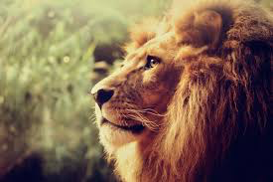
Who is Mrs. Lyon?

Slide 7
Professional Artist

Slide 8
www.ericalyonart.com
Art Shows
in Ogden
The Front – climbing gym(Dec. 2017)
Café Mercantile – 26th St.
Second Track Sports – 12th and Harrison
Blooming Lotus Café – 25th Street
Wasatch Roasting Co.(Nov. 2017)
Eccles Community Art Center State Show – 2 pieces 27th and Jefferson

Slide 9
Lived in Ghana, West Africa for 2 years teaching art to Deaf students

Slide 10
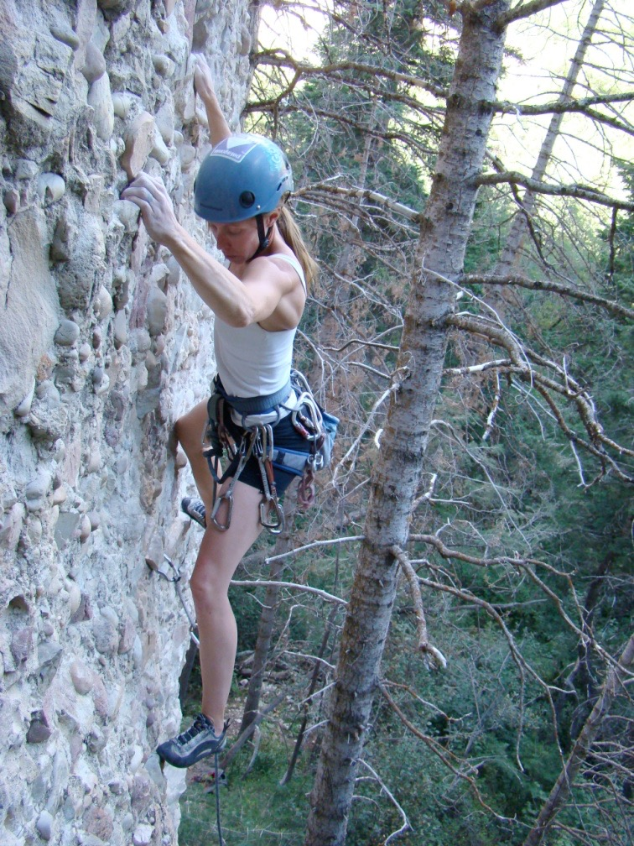
Climbing!

Slide 11
Backcountry Skiing

Slide 12
3 Ironman's completed!
2.4 mile swim, 112 mile bike, and 26.2 mile run

Slide 13
Love of my life!

Slide 14
Mrs. Lyon’s Teaching Thoughts about Art Class
Learning needs to be fun, challenging, and applied
Everyone and thing has value, treat it as such
Self-awareness is crucial in art, being able to take risks, and challenge yourself is key

Slide 15
Lyon’s faults
It’s challenging for me to spell
It take me a few months to memorize names

Slide 16
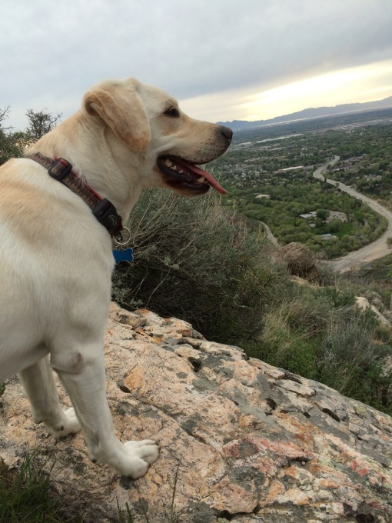
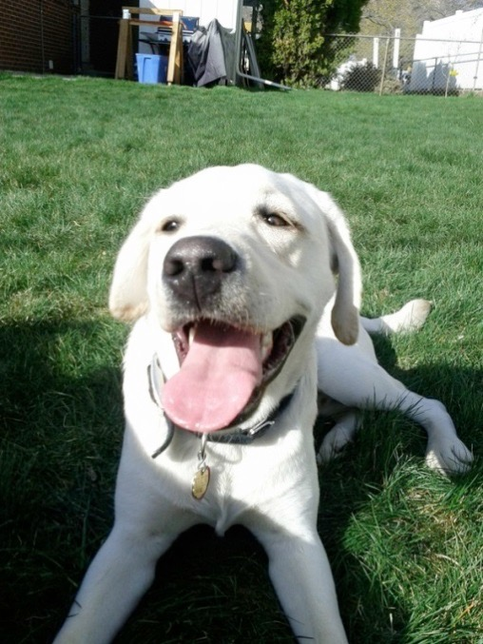
Griffin
Therapy dog ☺
No food, candy, or drinks in class
Let him chill on his matt in the back
During studio time he will be walking around
Greeting people at the door daily
No whistling or calling his name - thanks

Slide 17
Who are all of you?
Activity:
Find something in common with everyone at your table
Write it down on the whiteboard
Pick someone to share it with the class

Slide 18
Quick FYIs
Disclosures - get signed and bring back = extra credit
Recycling, sink, trash, paper towels, band aids
All art supplies you need for class will either be at your table, at the door to pick up or on the back counter
Everyone will have a file folder for all their papers
Tables and chairs - we move, they move
Art work will stay in your class folder
Hall Pass – you must have your planner to use them
Not during lecture, critique, or demo time, only studio time
Not during the 1st 10 min. or last 10 min. of class
Only 3 per term, must sign back of planner
Website! – www.classwithlyon.com & Remind app(sign-up)
Questions?

Slide 19
Art Shows
Face Painting Fundraiser – help AP pay for their exam and work at the football games painting faces for donations
Winter Art Show & Music Concert in the Commons at BLHS December 13th
Scholastic Art Competition due Dec. 7th, 2016 for more information go to: http://www.artandwriting.org/affiliate/ARALW/
Eccles Petite Impressions (under 8x8”) at Eccles Art Center in Dec. For more info visit: http://www.ogden4arts.org/competitions/
Utah State Senate Art Contest TBA
Utah State Art Show Jan. 16th – 20th, 2017 (intake to show)
Ogden Trails Network 3rd Annual Art Competition February 2017
Weber County Health Department Art Competition February/March of 2017
HOPE Art Competition around February or March of 2017
Art Gala in the commons at BL March 8th, 2017
Festival of Arts Beginning of April 2017 at Eccles Art Center
Recycled Art Competition Beginning of May 2017 at Eccles Art Center
Painting Competition at Eccles Art Center for more information: http://www.ogden4arts.org/competitions/

Slide 20
Disclosure
Review Disclosure together

Slide 21
Class Routine Each Day
Bell Work - BW
Essential Question - on the board
Agenda, reminders, review last class
Lesson – demos, mini lectures, etc.
Studio Time! - Creating your art!
Review – what’s going to happen next class
Exit Pass

Slide 22
Project #1: Symbol and Graffiti Art
Art A

Slide 23
Starter/Bell Work 8.24.2017
In your sketchbook on the 2nd page at the top write down answers to the following questions. Please save the bottom half of that page for your exit pass. Thanks!
1) In your own words what is a symbol?
2) What do you like( type of food, friends, family, sports, etc.)?
3) Try writing your name in a creative way.

Slide 24
Agenda 8.23 part 2
Starter/Bell Work
Agenda
Review Last Class
If you missed what do you do
Class website and file crate
First project
Symbols and lettering(street art with meaning)
Calendar and steps to the project
Studio Time
What that looks like
Clean-Up
Exit Pass

Slide 25
Project #1 – worksheet
Share with the people at your table your responses to the bell work
If you need to fix anything at this time please do so
As a group come to a conclusion about what you think the word symbol means, write your groups definition on the whiteboard, we will be sharing our definition with the class

Slide 26
Share Definition
Pick someone from your group to share the definition for symbol
Let’s come up with a definition that works for the whole class

Slide 27
Assignment #1
Symbol: something that represents something else
Example: this is a symbol for peace

Slide 28
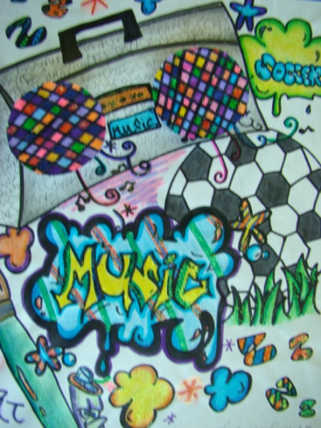
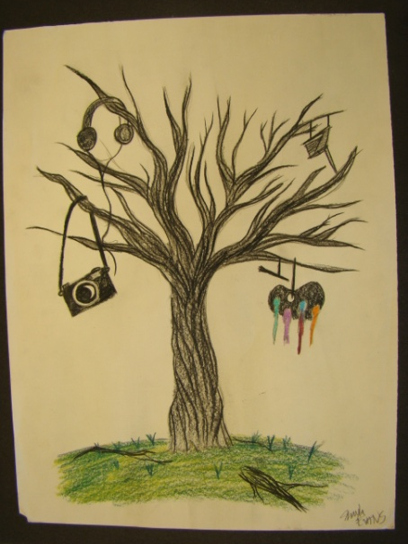
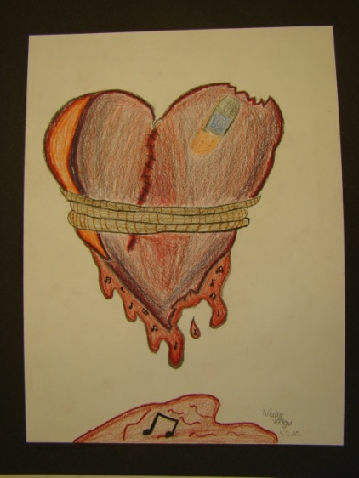
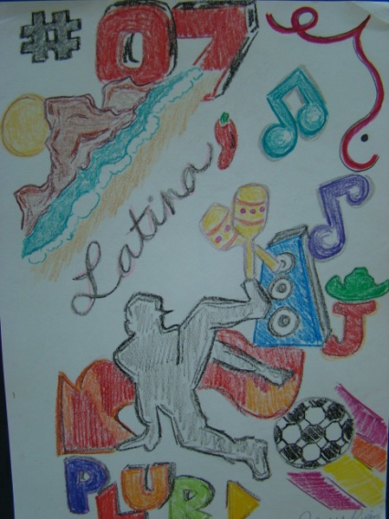
Symbols Assignment
Symbols in art are one of the oldest forms of visual communication and convey meaning beyond what's obvious.

Slide 29
Symbols will be combined with Graffiti
Today…
Symbols about you
Next class…
Graffiti of a word that goes with your symbol

Slide 30
One Example of Symbols

Slide 31
Open Studio Time
3 – 5 sketches of ideas for your symbol
In pencil on page 3 in your sketchbook
Symbol ideas can be anything that you think represents you
Be original (don’t copy symbols that are already out there that’s called plagiarism)

Slide 32
Next Class!
Graffiti lettering to go with your symbol
Continue working on Graffiti Symbols Assignment
Be ready for Bell Work again at the beginning of class! See you next class!
Enjoy your 4 days off (no school for students labor day and the Tuesday after)

Slide 33
Exit Pass page 2 of your sketchbook under your bell work
Looking at your symbols on page 3 that you drew, describe in three sentences what drawings represent you the most and why.

