Slide 1
Day 1 of 3 Filming!
Film 1

Slide 2
True/False for Filming Bell Work 9.10.2015
You can film in the gym unsupervised? - True or false
You can abandon your film group if you don’t like them - True or false
You can be on your phone when you are walking around the halls - True or false
You can use a tripod while filming – True or false

Slide 3
Agenda
Role
Groups
Shot styles & what not to do
Camera & tripods
Filming
Exit Pass

Slide 4
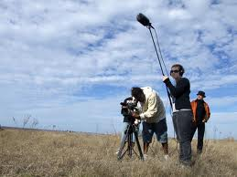
Filming!
The ‘No’s
No filming in the gym ☹
No filming in the E Hall ☹
You can’t film people that are not in your group ☹
No filming classes in session!
No leaving people in your group
The ‘Yes’s
You can film all over campus(except those places)! ☺
You can take as many shots as you need to in order to make your film look right
You can change your storyline
You can work with your group
You can have fun!

Slide 5
When You Are Filming…
Keep track of your time
Focus on filming
Make sure you can be found & make sure you are actively working (if not no participation points)
Double check to make sure your camera is charged
You are responsible for all the equipment
Questions?

Slide 6
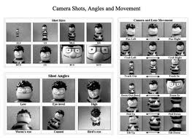
Shot Styles & Checking Your Shots
Take the list out with you
Make sure to get at least 3 shot styles, more = extra credit!
Double check your shots

Slide 7
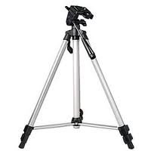
Cameras & Tripods
Cameras
No swinging around wrist
Treat better than your cell phone
If you break it, you buy it
Tripods
Be careful with
It’s not a sword
Know which parts move and which parts break

Slide 8
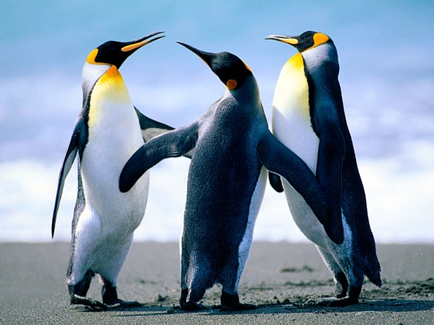
Group Work 9.9.2015
Write down everyone's name in your group and write down where you will be filming on the piece of paper(yellow) you have in your folder, one per group.
Pick up shot styles on the
desk when you walk in

Slide 9
Filming
Go out and film today
Sign out your camera and group
Hall pass
MAKE SURE I CAN FIND YOUR GROUP & YOU’RE ON TASK!
Be back on time for the exit pass
Questions?

Slide 10
Exit Pass 9.10.2015
Read the questions to the left of the agenda:
Respond to the question about how you accomplished that today?

Slide 11
Productions
We have the t-shirt for the yearbook add
What about making a film fundraiser with the Scottie dog logo? Or Film logo?
Films:
Announcements next Wed.
Highlight reel to go with Assembly?
Finish up:
Counseling video
Secretaries around the school
GearUp Video – talk with her(a crew)

