Slide 1
3.10.2015
E.Lyon

Slide 2
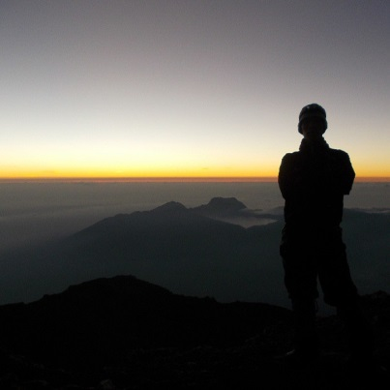
Term 3 Last Project
Studio – choice project, pick something that you want to do, make sure you can explain why you want to do this project
AP – continue working on your concentration, less than 2 months left!
Studio Time:
Grade checks
Ch. 8 Art & Fear(one more Ch. Left!)
Have a sketched completed by the end of class for your choice project, be ready to explain it

