Slide 1
Last Day
Art B
Mrs. Lyon

Slide 2
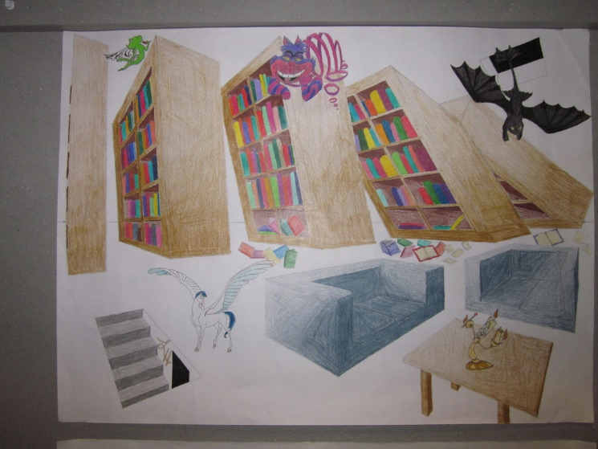
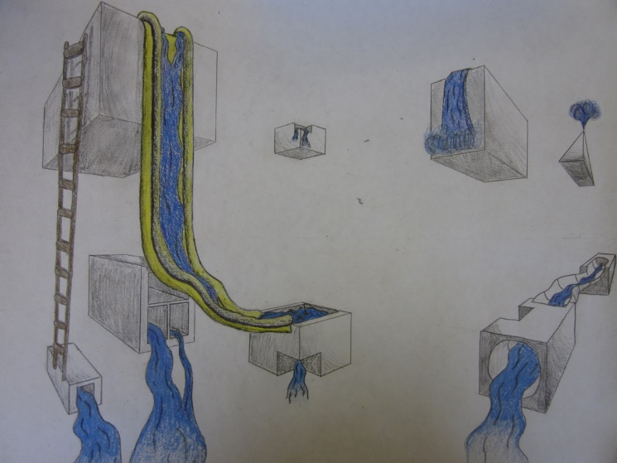
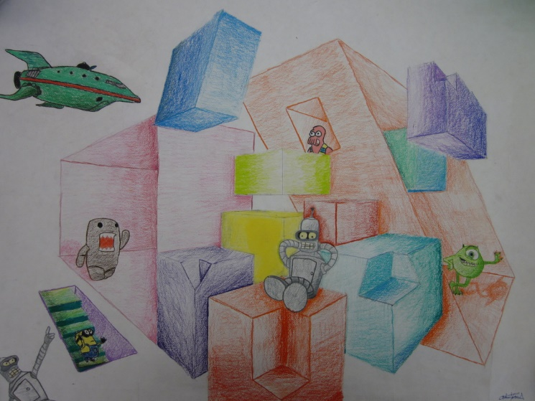
2 Point Perspective DUE Today
Goals last three classes
Complete 8 to 10 boxes
Have 6 to 8 shapes visually cut out of the boxes
Add your theme!
Have 4 to 6 characters or items from your theme
Turn in your project with your rubric

