Slide 1
Day 2 Recycled Art
E.Lyon

Slide 2
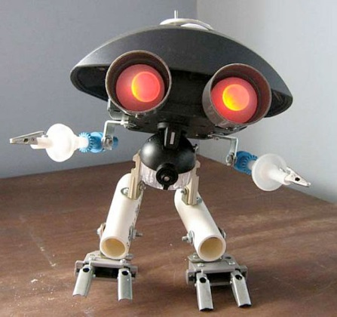
Bell Work 3.20.2017
1) Did you remember to bring trash for your art today? A) Yes –or- B) No
2a) If yes, how did you remember to bring it?
2b) If no, what can you do today in class to work on your project?
Get out your planner, if you have any unused hall passes from last term, we will add that as extra credit(reminder: you get 3 per term in your planner)

Slide 3
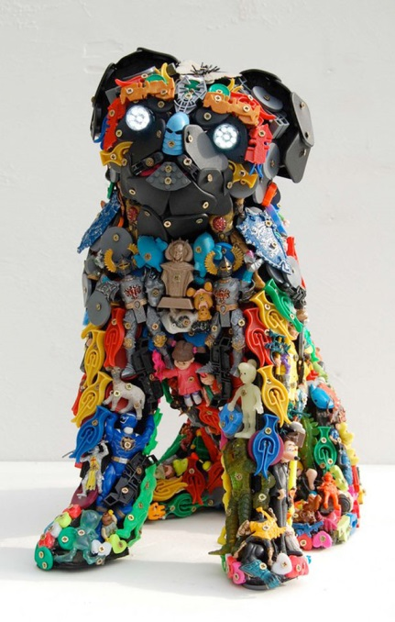
Agenda
BW
Review BW
Agenda
Studio Time – What it looks like & What happens if you don’t have any trash to make art out of =(
Clean-up
Exit Pass
Questions?

Slide 4
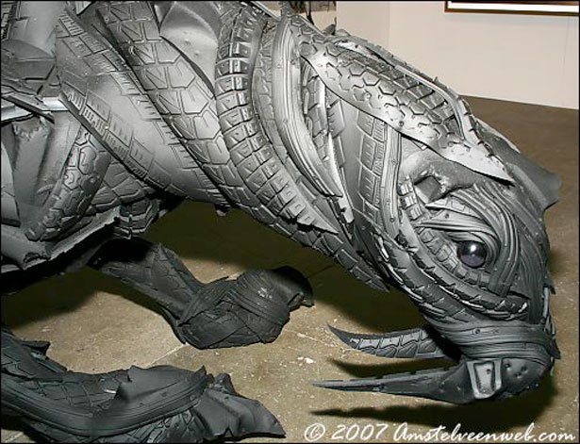
Garbage Art
Criteria
Safety Demo
Make sure everything is connected!
It’s made out of used stuff…that might have been thrown away if it wasn’t for you saving it and turning it into something beautiful!

Slide 5
Studio Time
Work on creating your Garbage/Trash Art Piece for the Eccles Art Show
Art Shows:
Festival of Arts – art show at the end of this month
HOPE art show at OHS this Thursday night
First Friday Art Stroll on 25th – April 1st
2 weeks till Spring Break
Reminder, project is due next week Thursday the 30th of March

Slide 6
Exit Pass 3.20.2017
What were you able to accomplish today on your project?
Do you need more trash for your project? If so, what are you going to bring from home?
See you all on Wednesday!
Reminder, project is due next week Thursday the 30th of March

