Slide 1
2 projects in one
11.5.2019

Slide 2
- We are starting two new projects, one you will need a picture of a pet or animal - The second you will need a snowy scene picture - Email both to me so we can print them out: lyone@ogdensd.org

Slide 3
One your snow stencil is cut out you will paint the first layer for the crackle paste media(using watercolor paper, let dry and then add the 2nd coat

Slide 4
Paint the background(with watercolor paints), leaving the crackle media white, you can paint the crackle media a little if you want

Slide 5
-Get your painting to a place where it feels done to you -You might need to let areas dry before you add other colors, so it doesn’t bleed

Slide 6
Animal Portraits

Slide 7
Paint the background
8 x 8 inch canvas – so we can enter it in the Petitie Impressions contest at ECAC
Could be a solid color, a gradation, or a pattern
Be thinking about what color you want to use for your animal so that they contrast enough to be able to stand out!

Slide 8
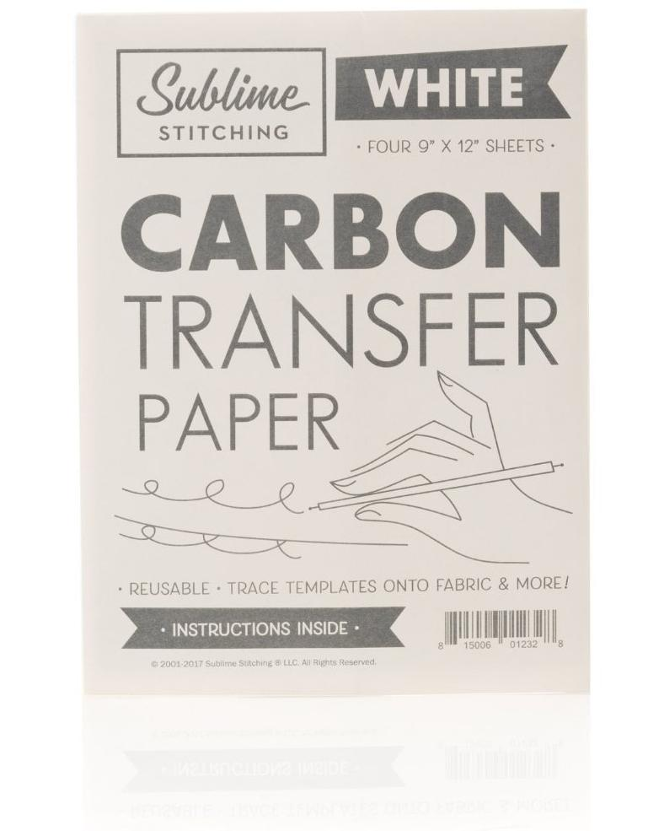
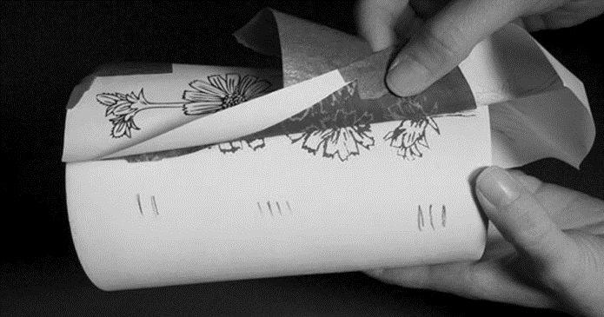
Once the canvas is dry
Trace your clean paper image onto the canvas using old school carbon copy paper!

Slide 9
After image is traced
Start filling the animal outline in with one solid color
You could make the center of the eyes all black and add a reflection of white
We also have a glossy paint we can add to the eyes if you want them to shine

