Slide 1
Google Doodle Project

Slide 2
Bell Work Day 1
Describe, in your sketchbook, three days that were the best days ever.
Be sure to include the following information:
Who was with you?
What was happening?
Where were you?
When did this day occur?
Why was it the best day ever & why was it happening?

Slide 3
What is Google Doodle?
Doodle 4 Google is a competition open to K-12 students of U.S. schools to create their own Google doodle.

Slide 4
Why is Google doing a competition?
Doodles are meant to surprise and delight people when they visit the Google homepage. Who better to surprise and delight than talented and creative young artists! Google would not exist today if it weren’t for creativity, passion, and imagination so we love to celebrate and promote these values in our younger users.

Slide 5
Google Doodle Examples

Slide 6
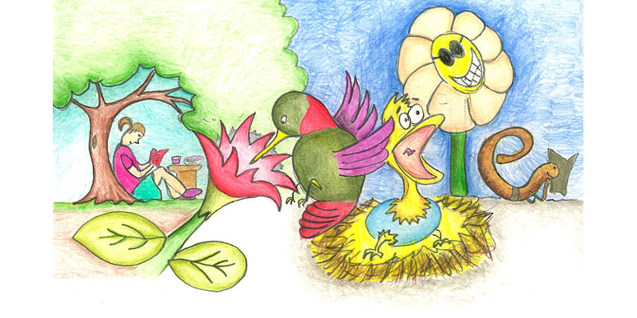
Past Winners
Title: “My best day learning about nature”
3rd Graders from Arizona

Slide 7
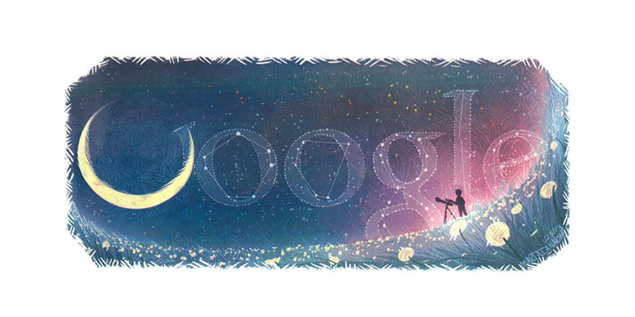
Past Winners
Title: “The Best Day Ever”
6-7 Grader From New Jersey

Slide 8
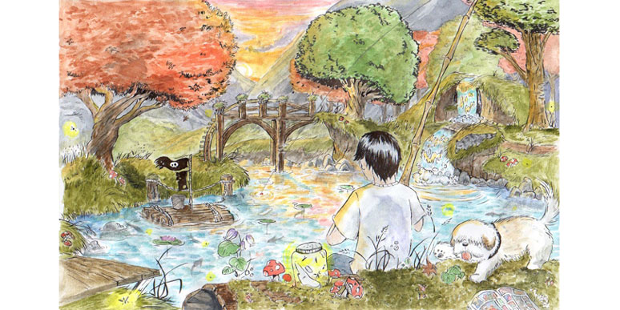
Past Winners
Title: “Afternoon Bliss
8-9 Grader From Maine

Slide 9
Google Doodle Theme Last Year
“My Best Day Ever”
Some potential examples of this year’s theme are:
•…was when I kicked the winning soccer goal.
•…will be when I travel to the moon.
•…was when my little sister was born.
•…was when I visited Spain.
•…will be when I go to college.

Slide 10
Google Doodle Prizes
The National Winner’s doodle will be featured on the U.S. Google homepage for 24 hours on May 23rd, 2013. He or she will also get a $30,000 college scholarship, a trip to New York City for the final awards ceremony on May 22nd, 2013, a Google Chromebook, a Wacom digital design tablet, and a t-shirt printed with his or her doodle on it. We’ll also award the winner’s school a $50,000 grant towards the establishment of a computer lab or technology programming.

Slide 11
Google Doodle Prizes
Each of the other 4 National Finalists will win a $5,000 educational grant to be used at the school of their choice, a trip to New York City for the final awards ceremony on May 22nd, 2013, a Wacom digital design tablet and a t-shirt with their doodle printed on it.

Slide 12
Google Doodle Prizes
Each of the other 50 State Winners will win a trip to New York City for the final awards ceremony on May 22nd, 2013, a t-shirt with their doodle printed on it, and their doodle–along with those of the National Finalists and Winner–will be featured in a special exhibit at the American Museum of Natural History.

Slide 13
Google Doodle Prizes
Each of the other 250 State Finalists will receive a certificate and see their artwork featured on the Doodle 4 Google website

Slide 14
Activity
Divide your paper into 8 sections.
In each section sketch a possible sketch for your google doodle.

Slide 15
How the Doodles will be Juried
To narrow the entries down to the top 50 State Winners, eligible doodles are judged by Google employees and our “Guest Judges” against the following criteria:
Artistic merit: based on grade group and artistic skill
Creativity: based on the representation of the theme and use of the Google logo
Theme communication: how well the theme is expressed
Appropriateness of the supporting statement

Slide 16
AP & Studio
Everyone needs to put at least one piece of art in the show or more
The show is this Friday
Matting today in class and next class
Studio Time!

