Slide 1
13 day project day 1
Drawing/Painting 3

Slide 2
Drawing/Painting 3 10.31.2019
Starting 13 day project!
Pick a theme
Create thumbnail sketches today for each day of your project (think about how your theme will be a common thread throughout your project)
Starting next class, we will start on day one of 13
You will create a piece of art each day in class

Slide 3
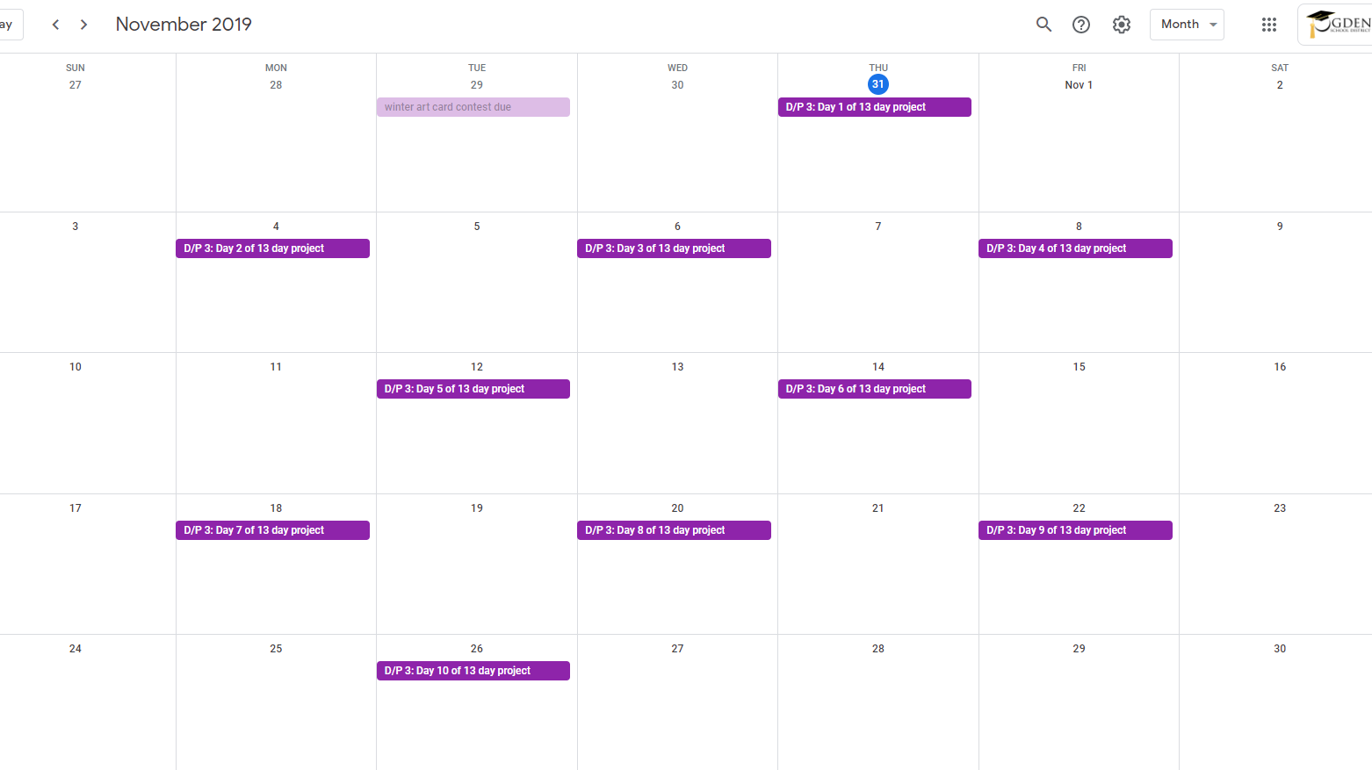

Slide 5
Goal 10.31.2019
By the end of class, have all the questions completed and thumbnail sketches drawing out
If you are done early, you could get a head start on the project and start with day 1, it will be due at the end of next class

