Slide 1
Proportion and Balance
E.Lyon
12.5.2014

Slide 2
Game!
At your table figure out what the following word means in art:
Proportoin

Slide 3
Scale
At your table figure out what the following word means in art:
Scale

Slide 4
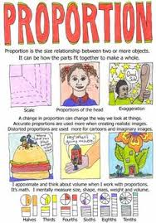
Proportion and Balance

Slide 5
Proportion
Scale
Size ratio to other objects

Slide 6
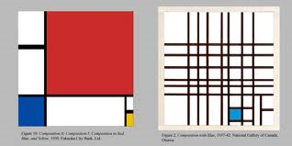
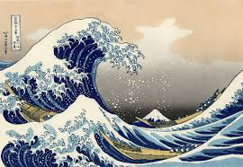
Proportion and scale

