Slide 1
Self-Portraits
Drawing
Mrs. Lyon

Slide 2
Bell Work 11.5.2019
What is the most challenging thing for you to draw on the human face?(Eyes, ears, lips, nose, forehead, chin, hair, etc. )
What is the easiest thing for you to draw on the human face?
What worries you the most when you think about drawing a self-portrait? Why is that?
If you finish with extra time, try to draw these things by themselves: eyes, nose, ears, etc.

Slide 3
Agenda
Review Bell Work
Talk to someone next to you about your answers to your bell work
Does anyone have tricks to drawing the things that are challenging for you?
Be ready to present one of the tricks you learned in your table groups.
Sketching Practice today to help with self-portraits
Self-Portraits!
Next class where parts of the face go on the face, proportions, and areas of the face
Goals
Exit Pass

Slide 4
Reminders…
Art Fees need to be paid $15- or $7- for fee wavier
If you do not pay your fee by the end of the term, it becomes a fine & your projects get recycled ☹

Slide 5
Review Bell Work
In your table groups talk about:
What is the most challenging thing for you to draw on the human face?
What is the easiest thing for you to draw on the human face?
What worries you the most when you think about drawing a self-portrait? Why is that?
Share technique ideas with group members that you have learned in the past about how to draw those things that are challenging for other people at your table group.

Slide 6
Sketching Practice Today
Eye
Ear
Nose
Mouth
Proportions of the Human Face

Slide 7
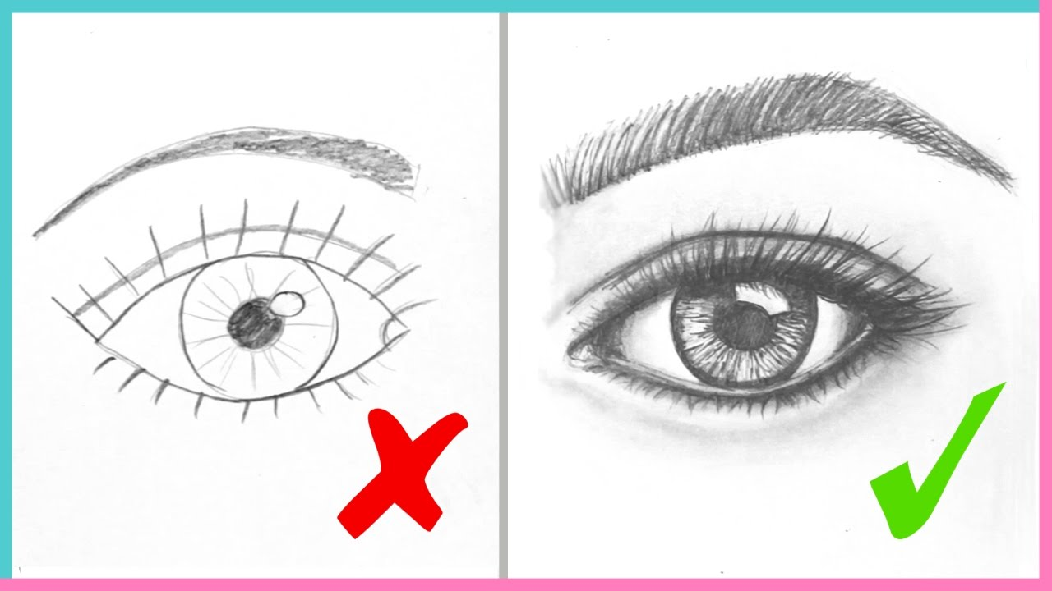

Slide 8
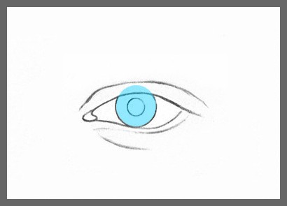
Eye

Slide 9
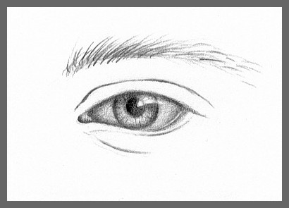

Slide 10
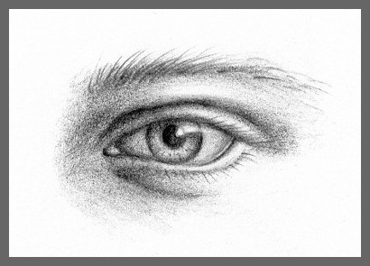

Slide 11
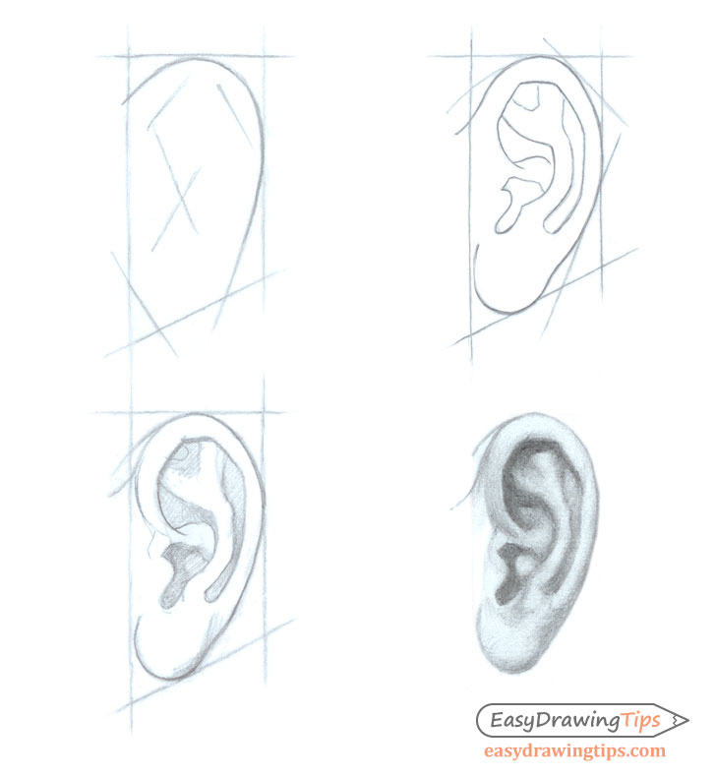
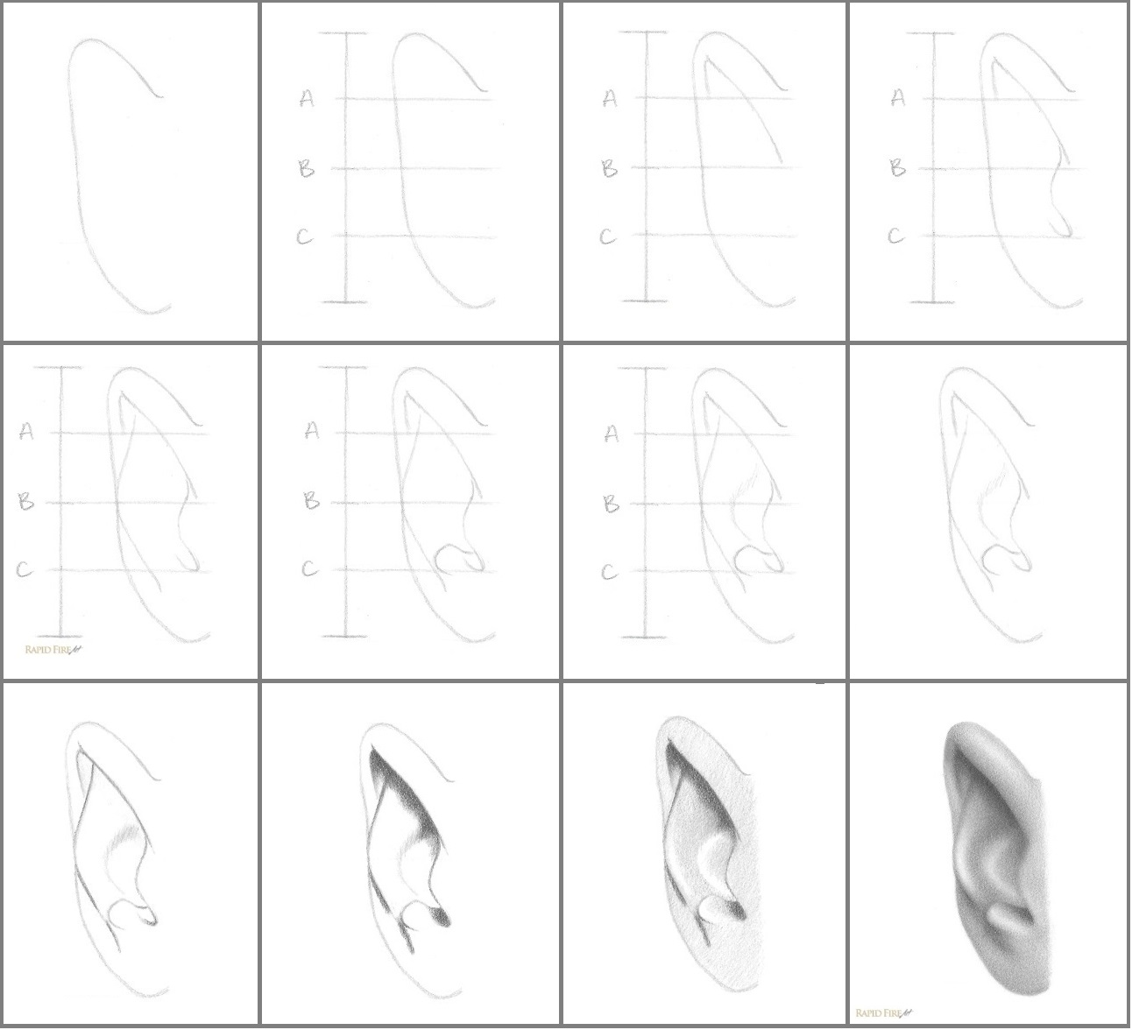

Slide 12
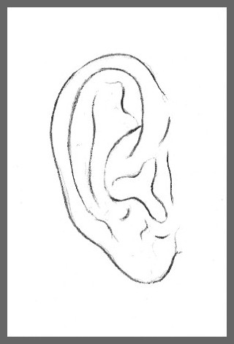
Ear 1

Slide 13
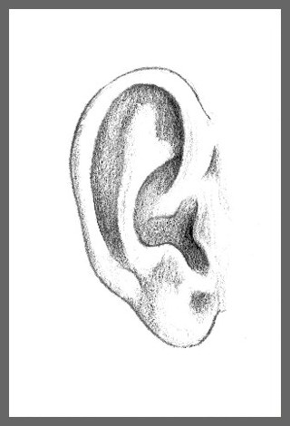
Ear 2

Slide 14
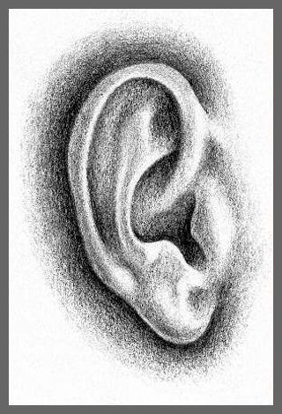
Ear 3

Slide 15
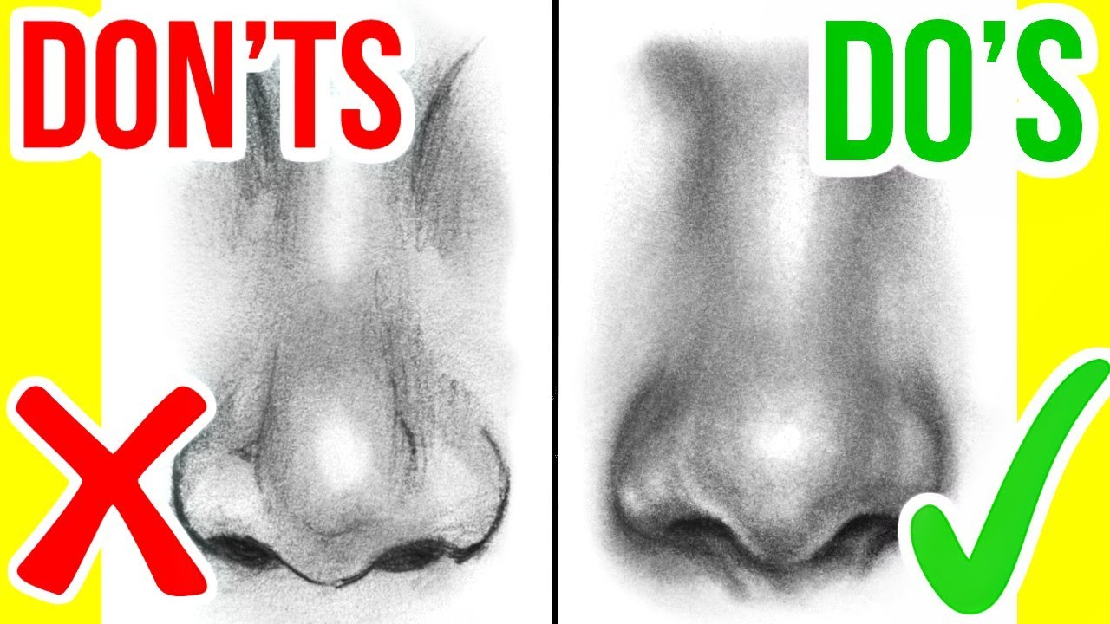

Slide 16
Nose 1

Slide 17
Nose 2

Slide 18
Nose 3

Slide 19
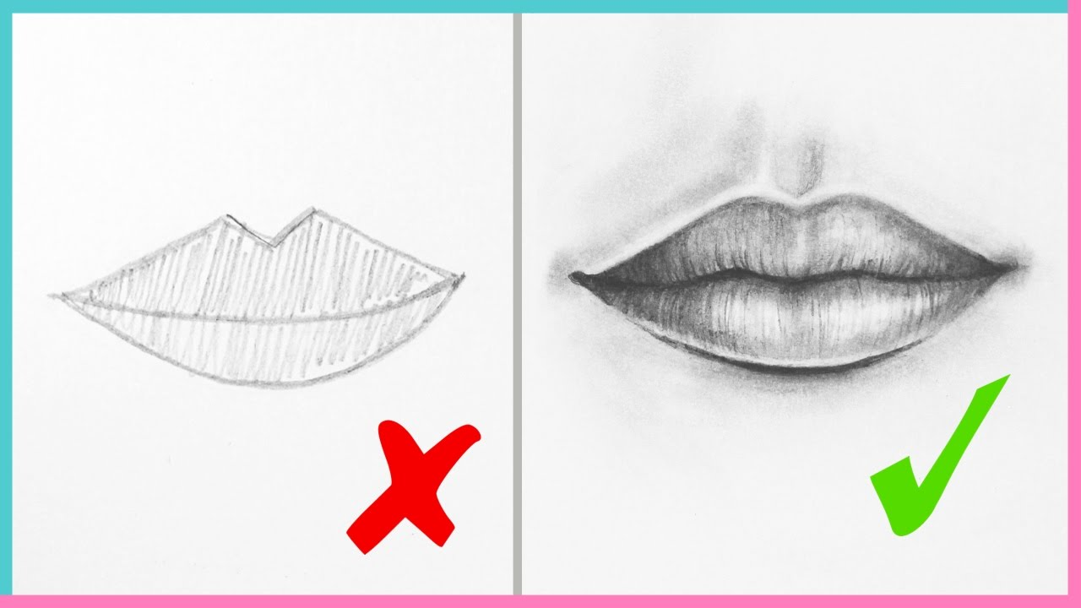

Slide 20
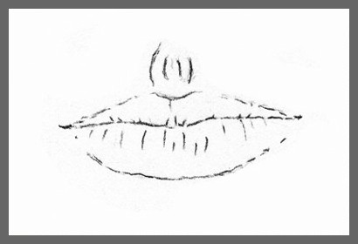
Mouth 1

Slide 21
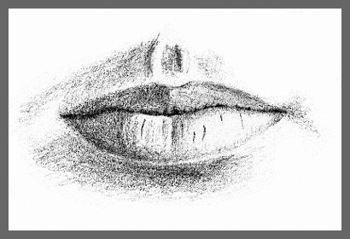
Mouth 2

Slide 22
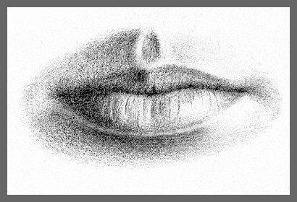
Mouth 3

Slide 23
Exit Pass 11.5.2019
What was the most challenging part of the face for you to draw in class today?
What was the easiest part of the face to draw today and WHY?
What was one trick you learned today about drawing a part of the face?
See you next class, we will start drawing out the entire face in proportion

Slide 24
Pencil Portrait Realistic Portrait
http://www.artyfactory.com/portraits/pencil_portraits/pencil_portrait_slideshow.html

Slide 25
Nose 1

Slide 26
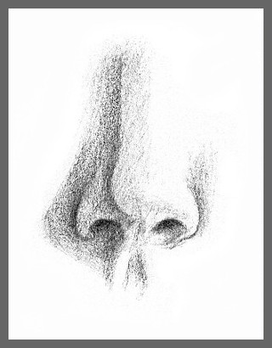
Nose 2

Slide 27
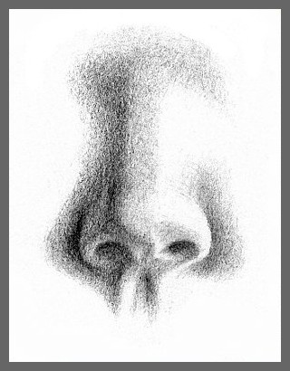
Nose 3

