Slide 1
10.7.2014
E.Lyon

Slide 2
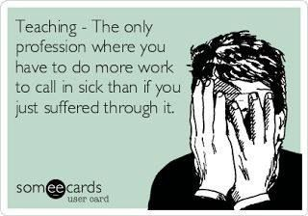
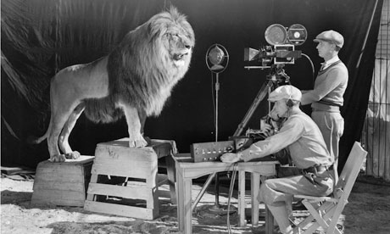
Last Day to Film!
Mrs. Lyon is sick, please be extra nice today, thanks.
Last day to film!
If you are ready to edit, start editing
60 min. class periods today

Slide 3
Minimum Day Schedule
First Bell @ 7:40 a.m.
1st Period 7:45 – 8:45 a.m. (60minutes)
2nd Period 8:50 -9:50 a.m. (60 minutes)
3rd Period 9:55 – 10:55 a.m. (60 minutes)
4th Period 11:00 – 12:00 p.m. (60 minutes)
Lunch 12:00- 12:30p.m. (30 minutes)
Teachers in meetings from 12:30-2:45pm

