Slide 1
Randomness
E.Lyon 2016 Art A Day 3

Slide 2
Starter 10.14.2016
Project #4 for Term 1 Art A
Pick up your art work on the cart
If you have anything sticking up in the teal crate pick it up, fix it and turn it back in so I can improve your grade

Slide 3
Review
10.14.2016
Apply either stippling or cross-hatching to your work when shading with the sharpies
Make sure your piece of art is balance and includes all the ‘things’ on the list, you can add more
Have fun, be creative with this assignment

Slide 4
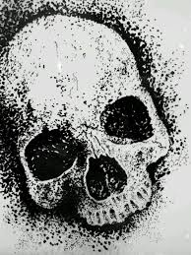
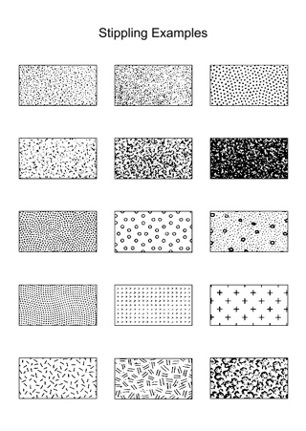
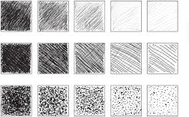
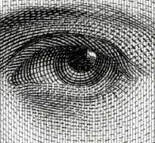
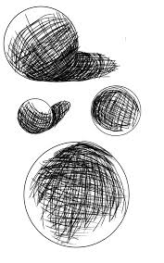
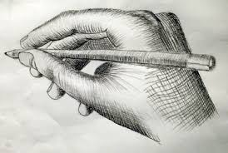
Stippling and cross-hatching
Shading with a pen

Slide 5
During Studio Time
Randomness project #4
Check out sharpies
If one is dried up just give it to me, so I can replace it
You should be done drawing on the final paper today with pencil and started with the sharpies

Slide 6
Randomness Expectations
Project #2 for Term 2 Art A
All these things need to be included in your project
➢ 6 cow spots
➢ 3 bulls eyes(targets)
➢ 4 areas with stripes
➢ Only use black and white
➢ 3 areas with checker board design
You can add anything else you want!
Questions?

Slide 7
Days to work on this: total 4
Project #2 for Term 2 Art A
Tuesday - Project #4: Randomness DUE at the end of class

Slide 8
What to Turn in on the way out
10.12.2016
Any missing work you need re-graded
Return all sharpies that you signed out
Tuesday, projects are due at the end of class, if you need more time on it, take it home for homework this weekend
Reminder: end of the term is the 27th of Oct., last day to turn in all your work from Term 1

