Slide 1
Watercolor Techniques 3.0!
E.Lyon

Slide 2
On Your Way in, pick up the following:
You will need everything in your folder, except your survey, hall passes and disclosure
Which includes:
Techniques 1.0, 2.0
BL mountain paintings x2
Reflection on BL mountain painting
Reflection about techniques 1.0
Thank you!
You will need scissors and a glue stick to share too!

Slide 3
A few reminders
If you miss class you can make work up
after school
Online using the class website and video tutorials that we film in class
Keep an eye on your grade
if you are missing something you know you did
check the no name wall
double check your folder
Check your backpack or binder – maybe you put it away

Slide 4
Where do things go?
Sketchbooks – hanging file
Paintings – your class period drying rack
Papers to turn in(surveys, reflections, disclosures, exit pass, etc.) – class period basket on the cart
Art fee – pay to Mrs. O’Grady (try to pay your fee by next month)

Slide 5
On Your Way in, pick up the following:
Brushes – one round, one flat – they are new!(some have been used once)
2 pieces of 90 lbs watercolor paper
Don’t worry about taping it today – we are going to do the techniques quickly and get to the fun painting!
Watercolors
Water and container
Paper towel

Slide 6
Agenda 1.22.2020
Pick up supplies
Reminders
Agenda
Reminders
Techniques 3.0!
Clean-up

Slide 7
Techniques 3.0
Overlapping colors
Hard and soft edges
Crayon resist
Tape resist
Paper masking
Negative painting

Slide 8
Overlapping colors

Slide 9
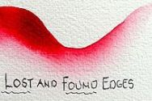
Hard and soft edges

Slide 10
Crayon resist

Slide 11
Paper masking

Slide 12
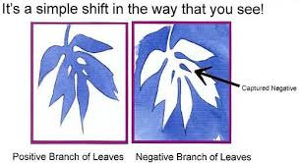
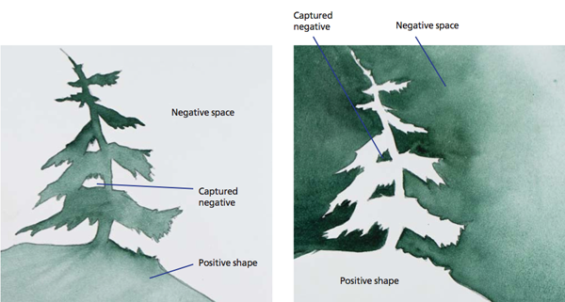
Negative painting

Slide 13
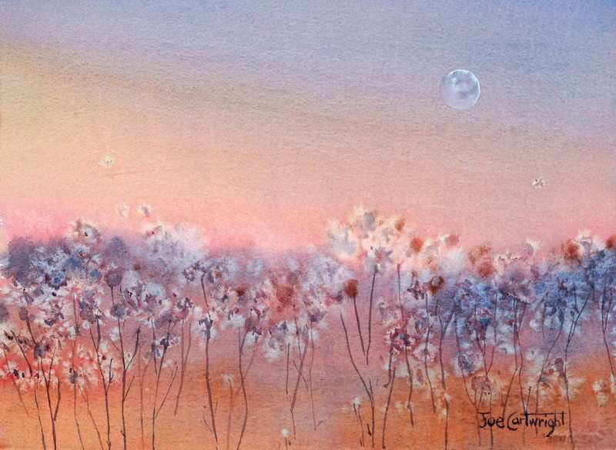
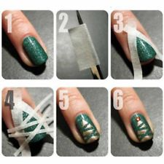
Tape resist with salt

Slide 14
Clean-Up
Put your paints back in the drawer
Double check and make sure none of your colors are mixed – if so clean it out please
Turn in any dry paintings on the drying rack with your class period – make sure your name is on each of your paintings

Slide 15
Exit Pass Reflection 1.22.2020
Out of the techniques today what was your favorite one:
Hard and soft edges
Crayon resist
Tape resist
Paper masking
Negative painting
2) and why(explain your response, justify it, support it)?
____________________________________________________________________________________________________________________________________________________________________________________________________________________________________________________________
3) How could you use that technique in a painting?
____________________________________________________________________________________________________________________________________________________________________________________________________________________________________________________________

