Slide 1
Find your paintings from last class
You picked up three different little papers at the door – we will be gluing them in your sketchbook along with your paintings
You will need:
Scissors
Glue and
Your paintings should be in your hanging folder
If not, you might not have written your name on it ☹
Please write your name on it and show it to Mrs. Lyon
When you have found you paintings please find a seat and wait for instructions

Slide 2
Watercolor 2.0 1.17.2019
E.Lyon

Slide 3
Bell Work – DO 1.17.2020
You will need:
Watercolor paper
A water container with water in it
A round brush
A flat brush
Paper towel
Set of watercolor paints
Thanks for being ready with your supplies!

Slide 4
Agenda 1.17.2020
Bell Work – DO
Agenda
Experiment first
Learn and Do techniques 2.0
Free paint applying one of the techniques we learned today
Clean-up

Slide 5
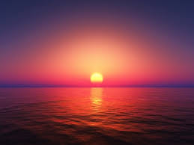

Slide 6
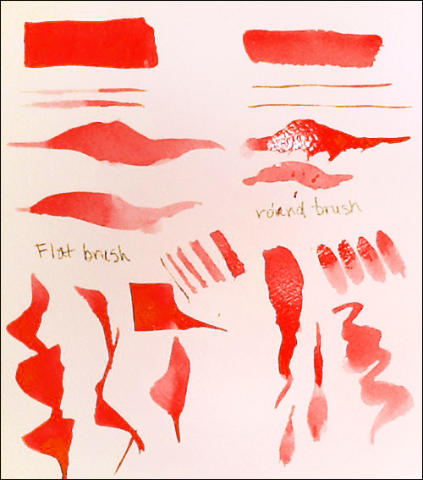
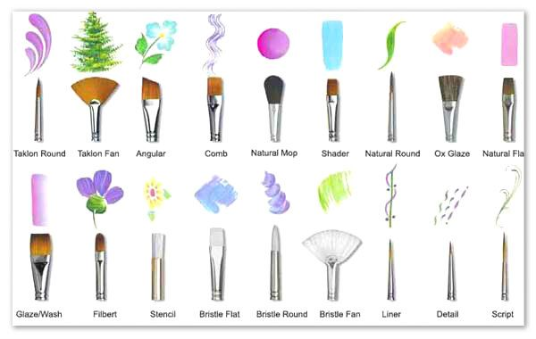
Flat and Round Brushes

Slide 7
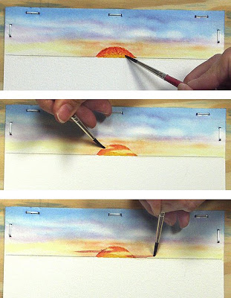
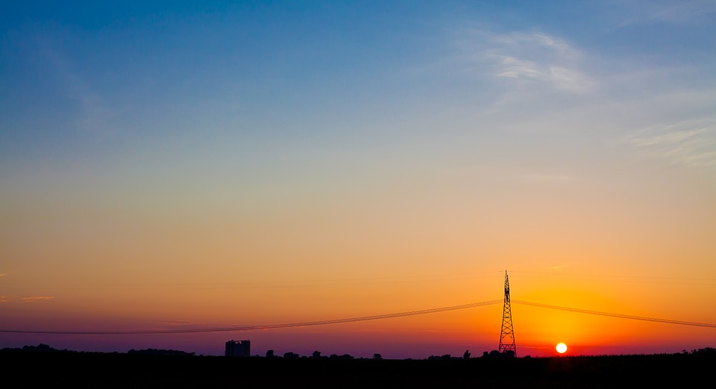
Sunset

Slide 8
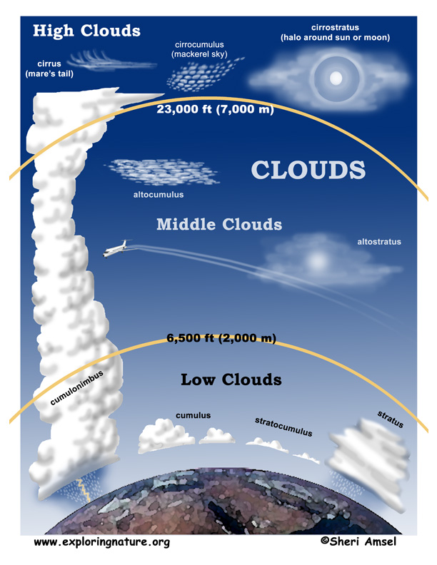
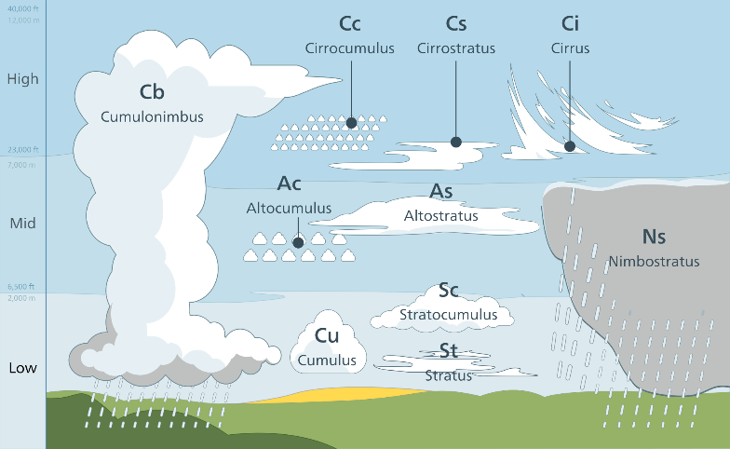
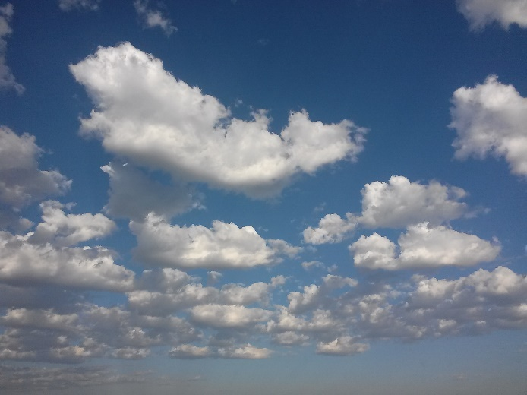
Clouds – lines with pigment on wet paper

Slide 9
Free paint Apply one of the technique we learned today

Slide 10
Next Class We will work on more techniques! And glue in Techniques 1.0 & 2.0 into our books Please make sure to pay your class fee, $15- to the bookstore, thanks!

Slide 11
Reflection on 2.0 Techniques Day 1.17.2020
Which piece is your favorite and explain in at least one to two sentences why this one is your favorite.
Which piece do you feel like you achieved the technique you learned in class today? Explain how you achieved that technique.
Which piece didn’t go well? Explain what you think wasn’t working for you or what your struggle was.

