Slide 2
First Day Drawing 2
1.13.2020

Slide 3
Welcome back to Drawing 2 1.15.2020
At the door you will need to pick up:
Disclosure
Your - Different Types of Line Notes
Thanks!
You will need two small pieces of paper for class too
__________________________________________________
If you were not here last class you will need to make up the work you missed on your time – before school, after school, lunch, or during studio time(when we are all working on our projects) You can find all the content you missed on the class website by visiting: www.classwithlyon.com and going to your class – Drawing 2

Slide 4
Agenda 1.15.2020
Gather supplies at the door
Disclosure
How to make up a class if you missed it
Dem & visual notes
Sketch out ideas for your project
Exit Ticket – turning in your two drawing from today
Questions about today?

Slide 5
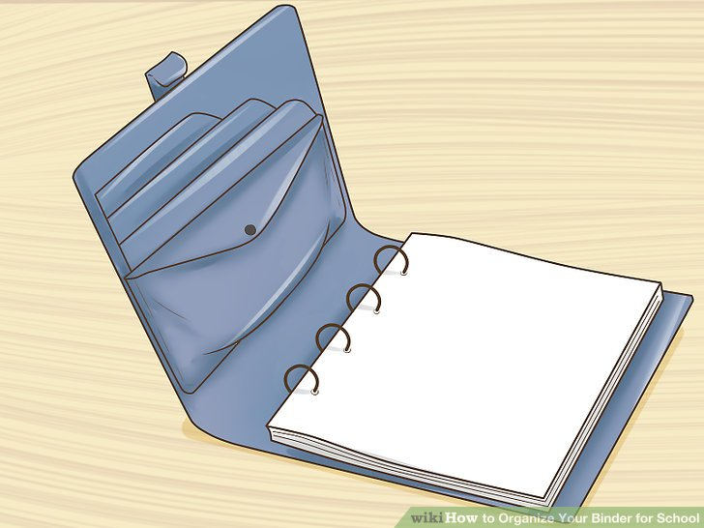
Disclosure
Review Disclosure together

Slide 6
How to make up class if you miss
If you miss a class you will need to make up the work you missed on your time
before school
after school
Sometimes during lunch
During studio time(when we are all working on our projects)
You can find all the content you missed on the class website by visiting: www.classwithlyon.com and going to your class – Drawing 2

Slide 7
Review Last Class
Types of Lines
Drew an object in the room

Slide 8
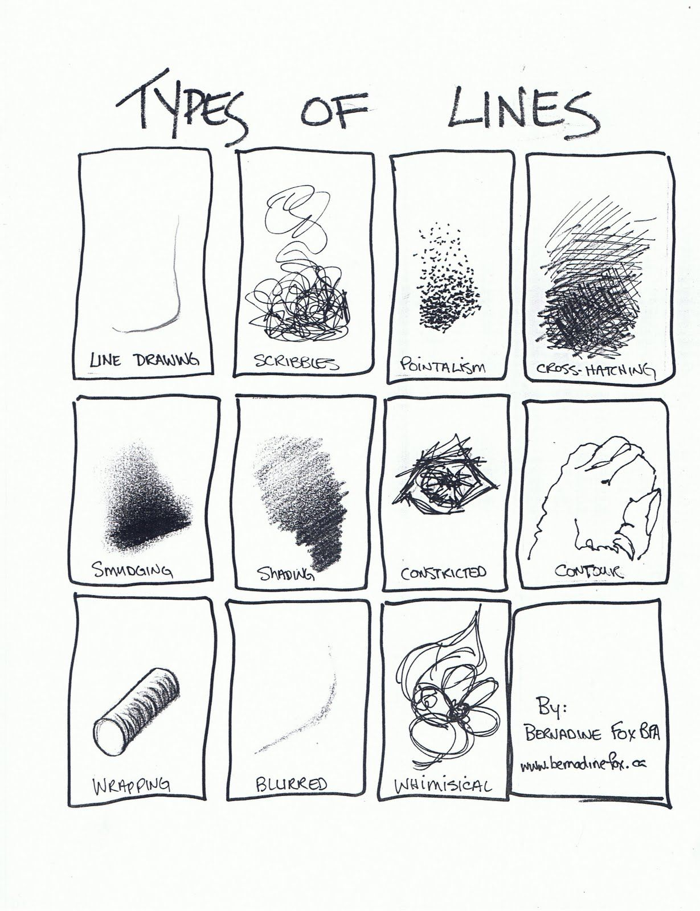
Type of Lines
Line drawing
Scribbles
Pointillism
Crosshatching
Smudging
Shading – blended gradation
Constructed
Contour
Wrapping
Blurred
Whimsical

Slide 9
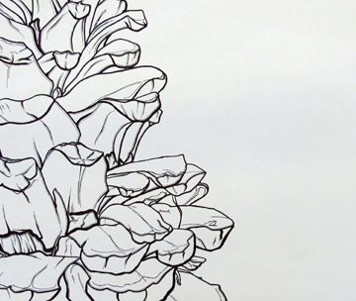
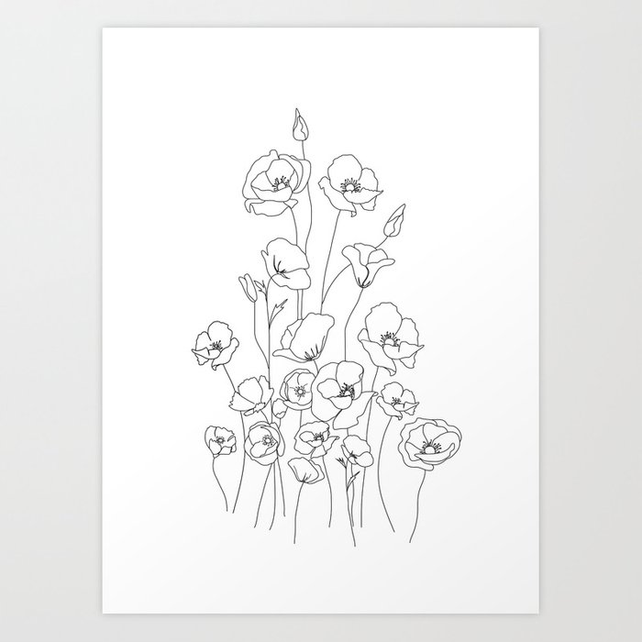
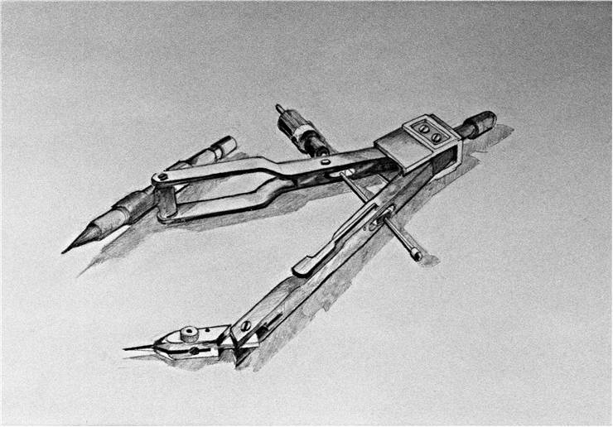
Making intentional lines

Slide 10
Visual Notes 1.15.2020
Defining your drawing space
Try to bring your drawing to the edge of the space in at least two places
Types of compositions

Slide 11
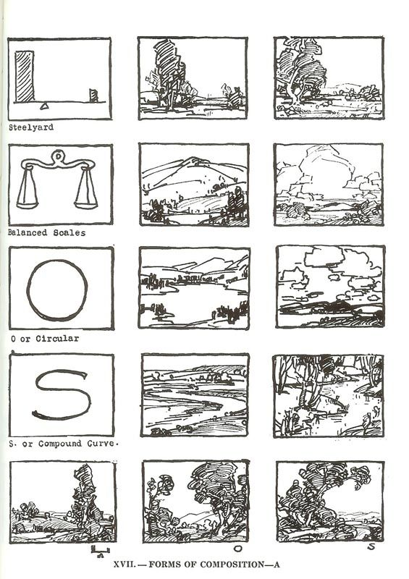
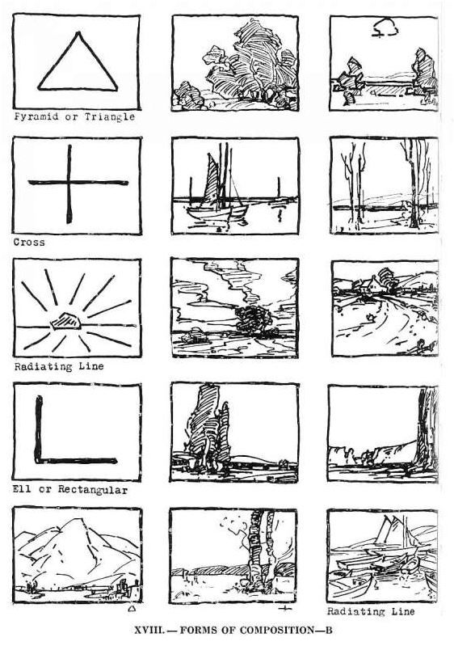

Slide 12
Black & White Contest
Sketch out your idea first, let’s chat and then get the final paper for you
We will be using 8 x 10 paper and pen
You will need to define your drawing space, do not make it more than ¾ less than your paper
Have at least 2 of the objects you are drawing touch the edges of your defined space
Use at least 2 of the line types we learned the first day of class
Please do not copy someone else’s work – feel free to get inspired by images, combine them and use multiple references to make the art as unique as you are
This will be day 1 of 4 working on this project
Due at January 24th, 2020

